Slide 1
BioBeo
BioBeo Experiments to Try

Slide 2
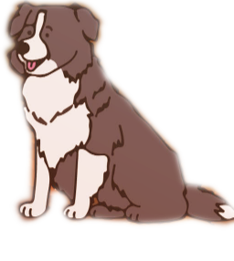
Content
Introduction
Grass Paper
Bioplastic
Bio Enzyme Cleaner
Rain Water Filter
Summary

Slide 3
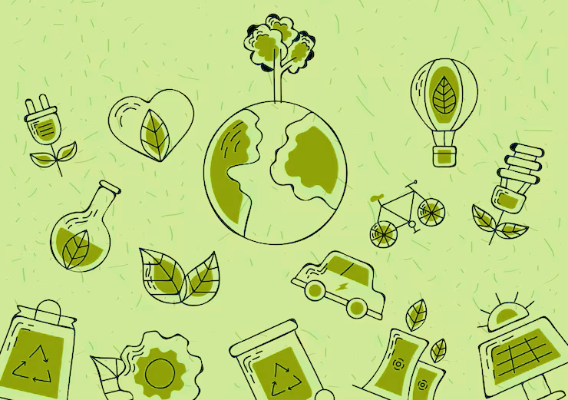
Introduction
Bioeconomy is all about sustainability, using bio-based products and recycling bio-waste to create products that are easily degradable and processes that are not harmful for the planet.
Using bio-based products and services not only reduces strain on fossil fuels usage, but it is also less detrimental for the planet.
Using bio-based products and implementing processes and services in homes and communities will help in creating sustainable and greener community.
In slides that will follow, there are products and processes that you can create yourself and try.
Maybe through your motivation you will be able to implement some of them at community level.

Slide 4
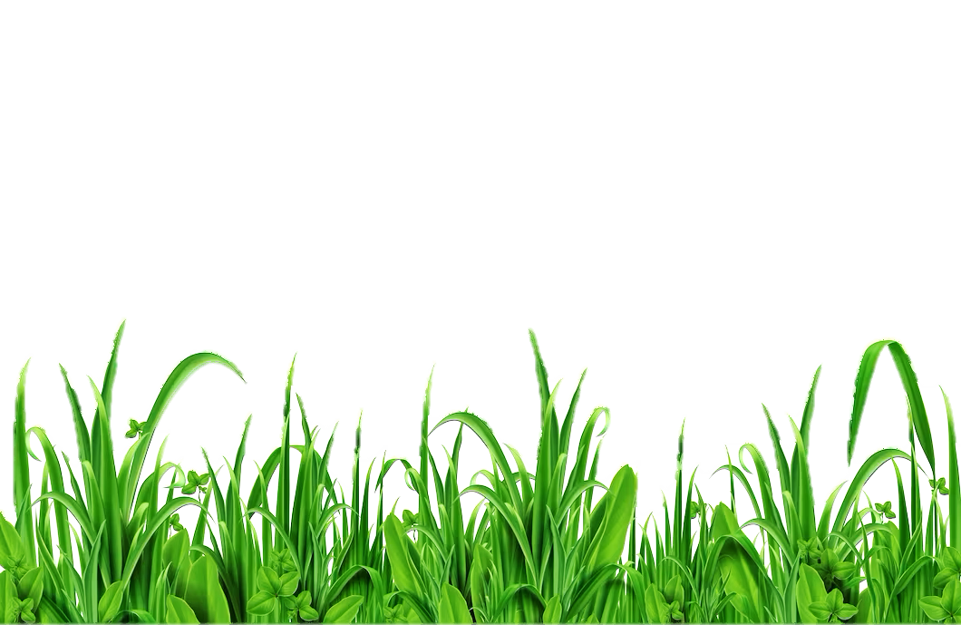
Grass Paper
Grass grows everywhere, and believe it or not, can be used to produce paper.
Like many of the plants, grass also contains the basic material cellulose which is used for paper making.
Depending on the grass type, the grass pulp quantity varies between 10–60% for creating proper paper using a process developed by Creapaper.
Advantages of Grass Paper:
Grass paper saves water.
Grass paper saves Energy.
Grass paper has no chemicals.
Grass paper is easier to produce as it doesn’t have high percent of lignin and resin.
As grass is readily available everywhere and requires less transport the emission is less.
Grass paper is easily compostable without harm.
Grass paper doesn’t contribute to deforestation.

Slide 5
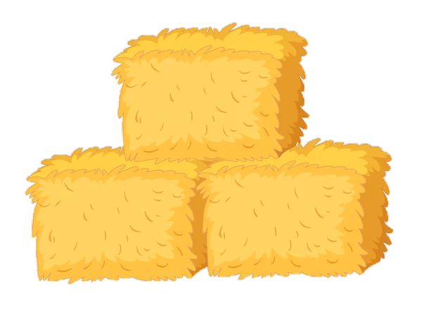
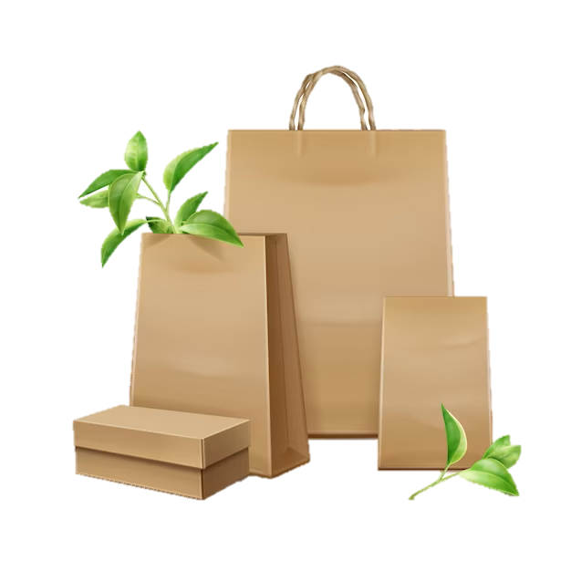
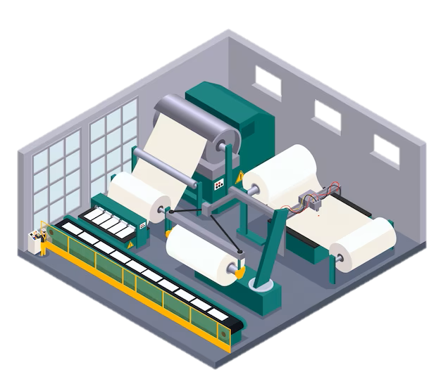
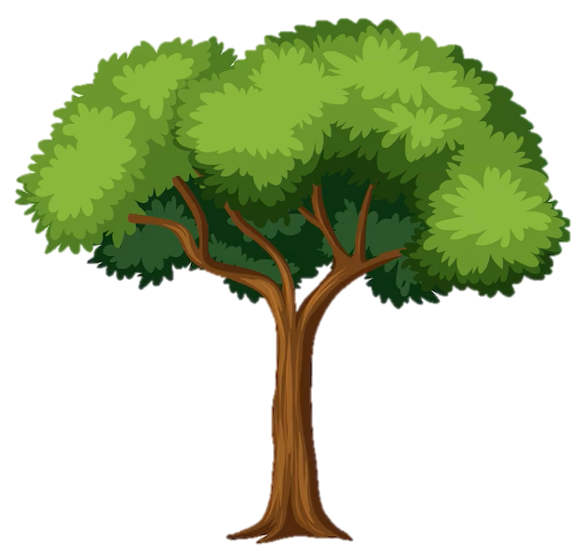
Grass Paper
Process of Making Grass Paper by Creapaper
The dried grass is then processed by cleaning, cutting and pressing into grass pellets
Grass
Dried grass is collected
Dried Grass is transported
Depending on requirement up to 60% grass pellets + Recycled paper or Fresh wood fibres or both can be used to create pulp
Final products
Paper Production Machine
Grass Pellets
Fresh wood fibres
Recycled Paper

Slide 6
Grass Paper
Things you will need to make Grass Paper by Yourself
Raw material – grass (can be dried grass)
Chopping/ cutting board
Knife/ Cutter
Larger container to wash and clean
Old cooking pot to boil the cleaned grass (check with adults in your house)
Washing soda
Blender (check with adults in your house) or hand beater to make pulp
Mould and deckle frame can be made at home
Tub/ vat larger than the mould and deckle
Sponges/ and sheets of cloth
You can always use other types of material such as cardboards, wooden boards, canvas which might be practical and available.
If possible, work outside and not in kitchen.

Slide 7
Grass Paper
Try Yourself

Slide 8
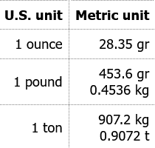
Metric Conversion
Use the below tables for conversions or online metric conversion tools where required.

Slide 9
Bioplastic
Bioplastics are created from renewable resources which are biodegradable.
They help in combating the problem with millions of tons of plastic waste which is littering across land and oceans, and harming marine and wildlife.
Bioplastics are being manufactured from various bio resources, algae's, by fermenting raw vegetables with a series of bacterial strains, sugarcane, potato starch, corn starch, etc.
Bioplastics that are biodegradable include versions like polylactic acid (PLA), polyhydroxyalkanaoates (PHA), polybutylene succinate (PBS).
Advantages of Bioplastics:
They reduce the carbon footprint.
They use less energy for production compared to traditional plastics.
They do not contain non-renewable raw material.
They help in reducing the non-degradable plastic waste.
They do not contain chemicals that are harmful to health.
They do not affect the food that gets packed into it.

Slide 10
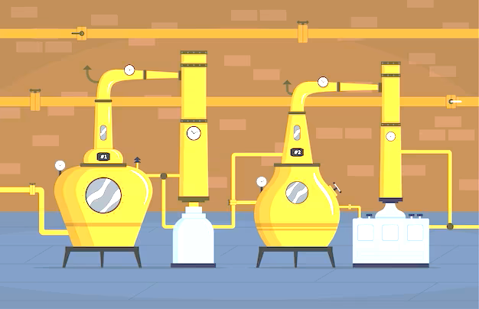
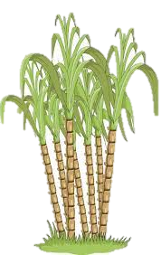
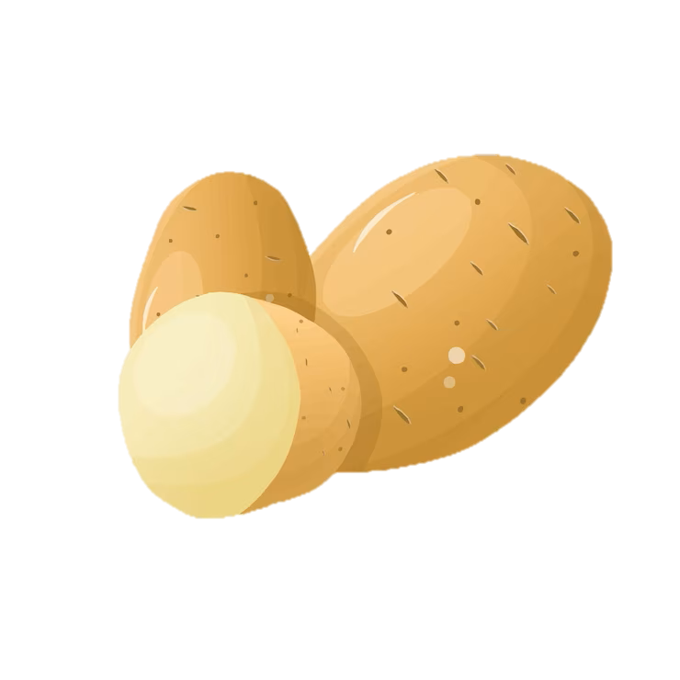
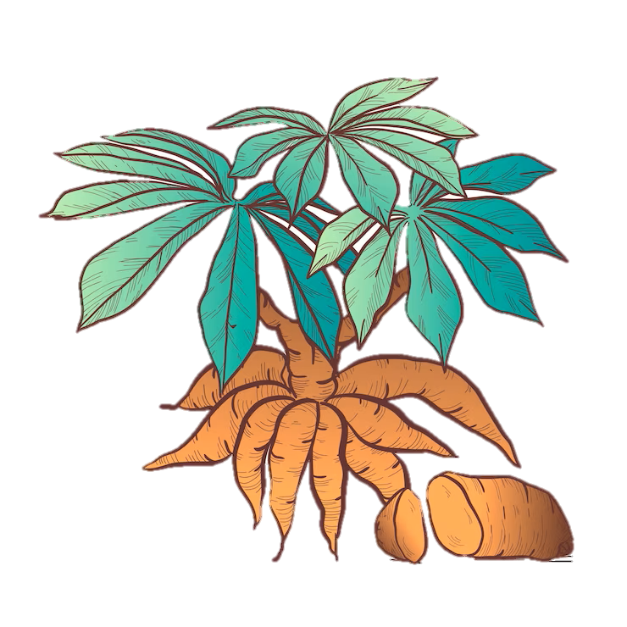
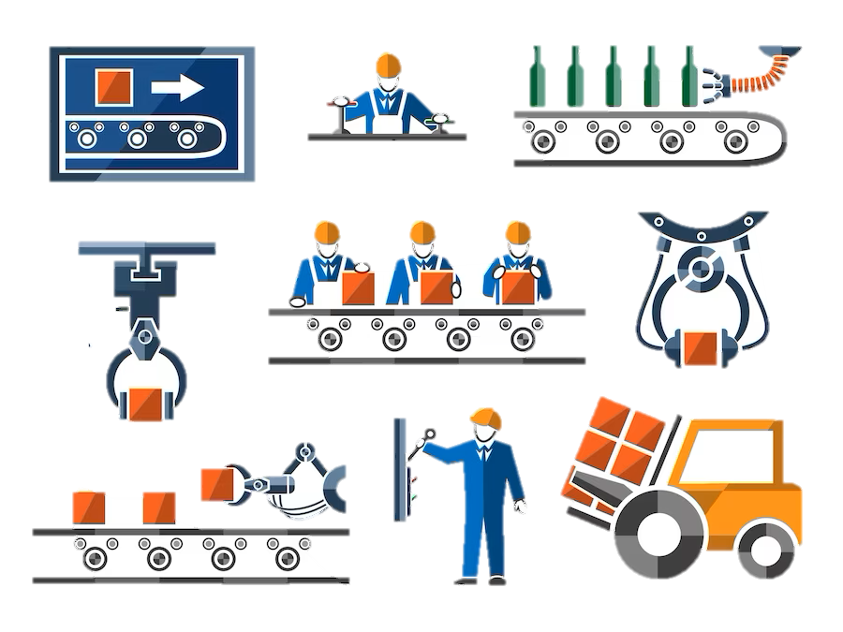
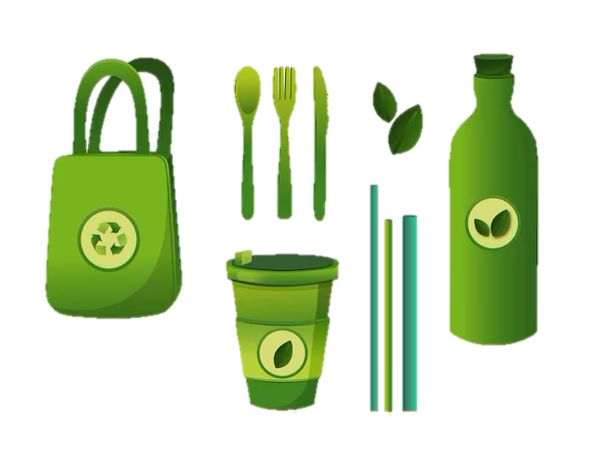
Bioplastic
Bioplastic Making Process
1. Raw Material Growing / Collection
2. Extraction/ Dissolving of Biomaterial
3. Adding compounds to make Bioplastic
5. Final Bioplastic products
4. Manufacturing products from Bioplastic

Slide 11
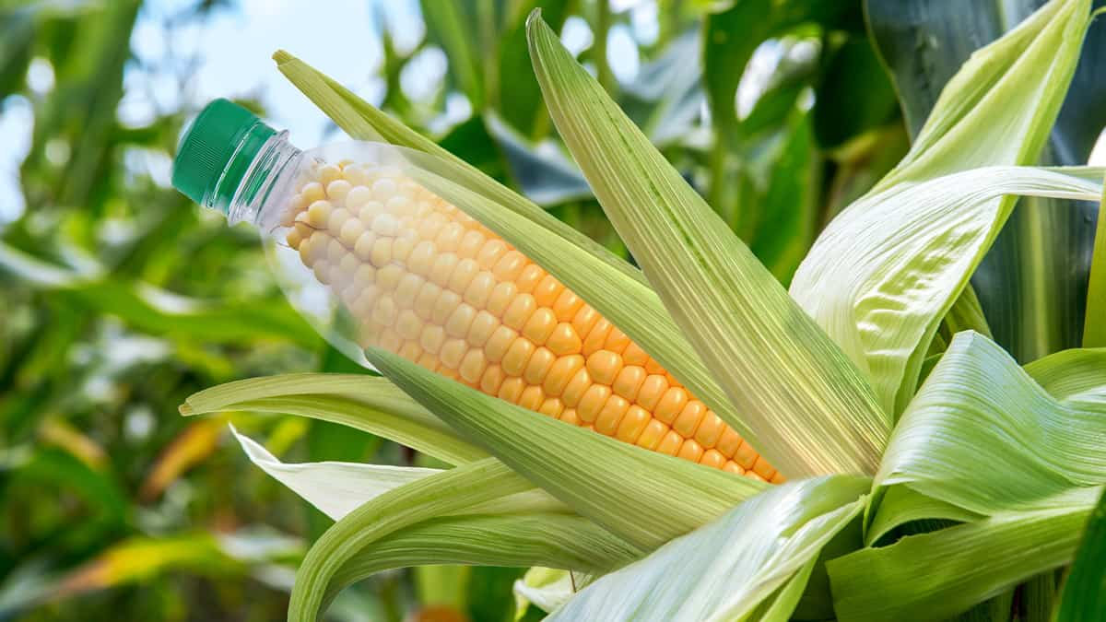
Bioplastic
Supplies Needed to Create Bioplastic
Starch – Potato/ Corn
Water
Vinegar
Glycerine
Bowl
Heat source
Kitchen Towel
Measuring spoons/ Scale
Tray/ Mould/ Flat board
Oven Mitts
Pan
Spatula
Food colour (optional – if you want to add colour to your plastic)

Slide 12
Bioplastic
Try Yourself

Slide 13
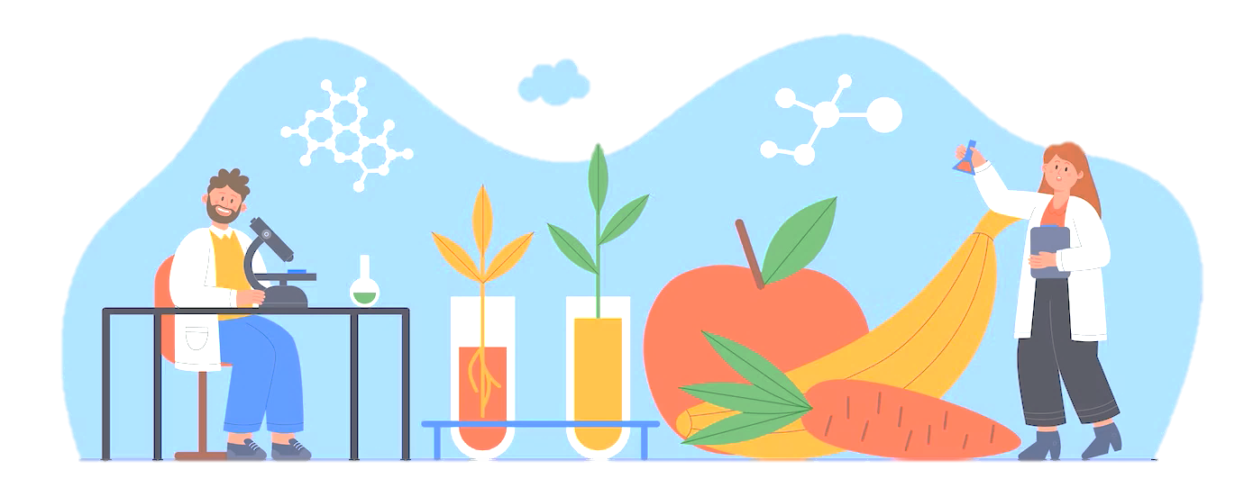
Bio Enzymes Cleaner
Proteins known as bio enzymes are created by microorganisms including bacteria, fungus, yeast, and algae. They are employed to decompose biological materials and transform it into valuable products. Various Bio enzyme products for various uses can be produced using different raw materials. For example: Bio enzyme cleaners. Bio enzymes are also known as “garbage enzymes”.
Different types of enzymes included in bio enzyme cleaners:
Proteases: Capable of dissolving protein-based substances like blood and food.
Lipases: Degrades grease and fat.
Amylases: Degrades all molecules of starch.
Cellulases: Soften the cloth and bring back the fibres' original colour.
Advantages of Bio-enzyme cleaners
Bio-enzymatic cleansers promote sustainable living and are environmentally friendly.
Traditional chemical cleansers cannot remove stains from narrow gaps and fractures like the microorganisms can.
Compared to the harmful chemical cleansers that are sold on the market, they are cheaper.
They promote a zero waste lifestyle since it is an environmentally friendly approach to maintain the home.
The lakes and subterranean water are not contaminated by the cleaners.

Slide 14
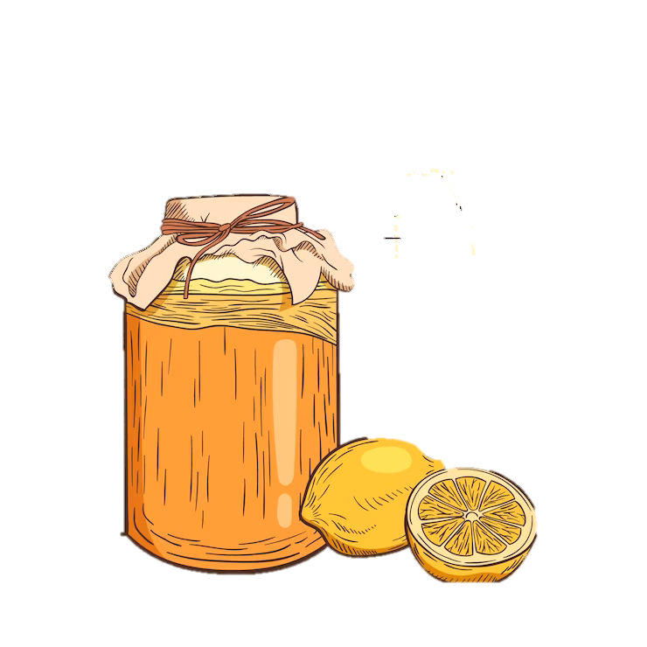
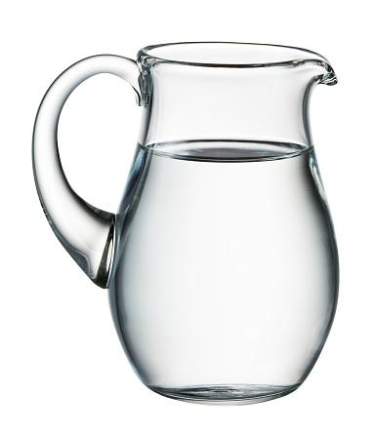
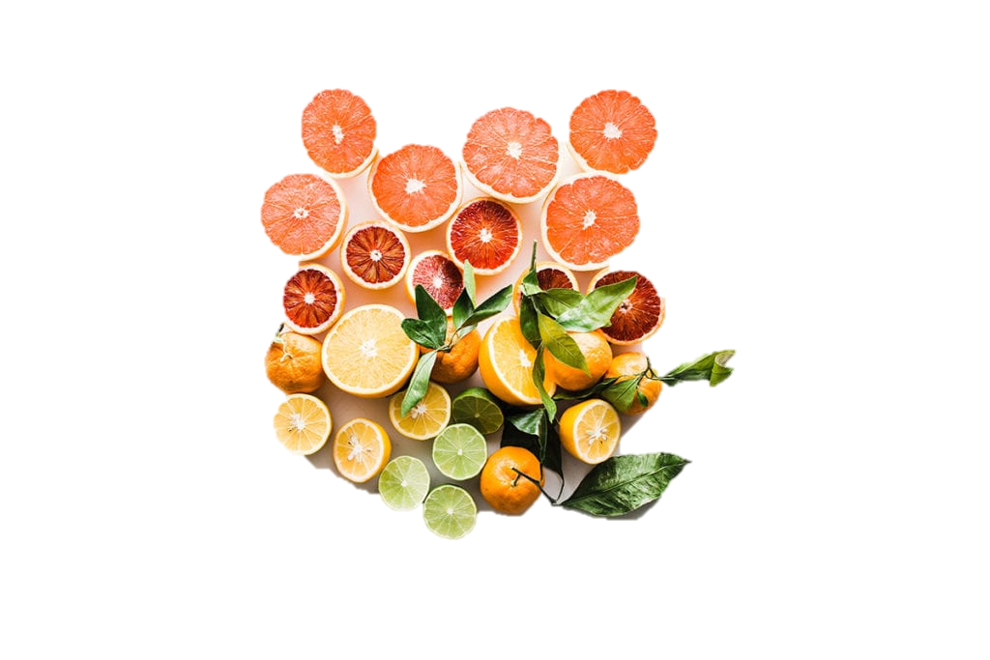
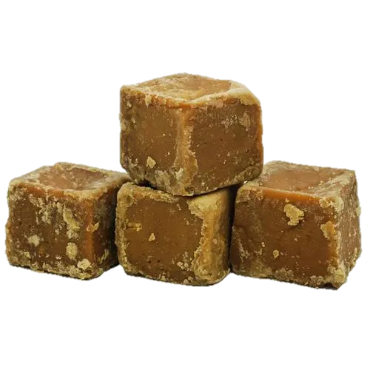
Bio Enzyme Cleaner
Bienzymatic action
Process of Making Bio enzyme Citrus Cleaners
Raw Material/ Citrus Waste
Jaggery/ Organic Brown Sugar
Bio enzyme Saturated Cleaner
Water

Slide 15
Bio Enzyme Cleaner
Supplies Needed for Making Citrus Bio enzyme Cleaner
Orange peels
Used lemon pieces/ lemon pieces
Used Lime pieces/ Lime pieces
Water
Jaggery/ Palm sugar or Organic brown sugar
Large bottle/ container

Slide 16
Bio Enzyme Cleaner
Try Yourself

Slide 17
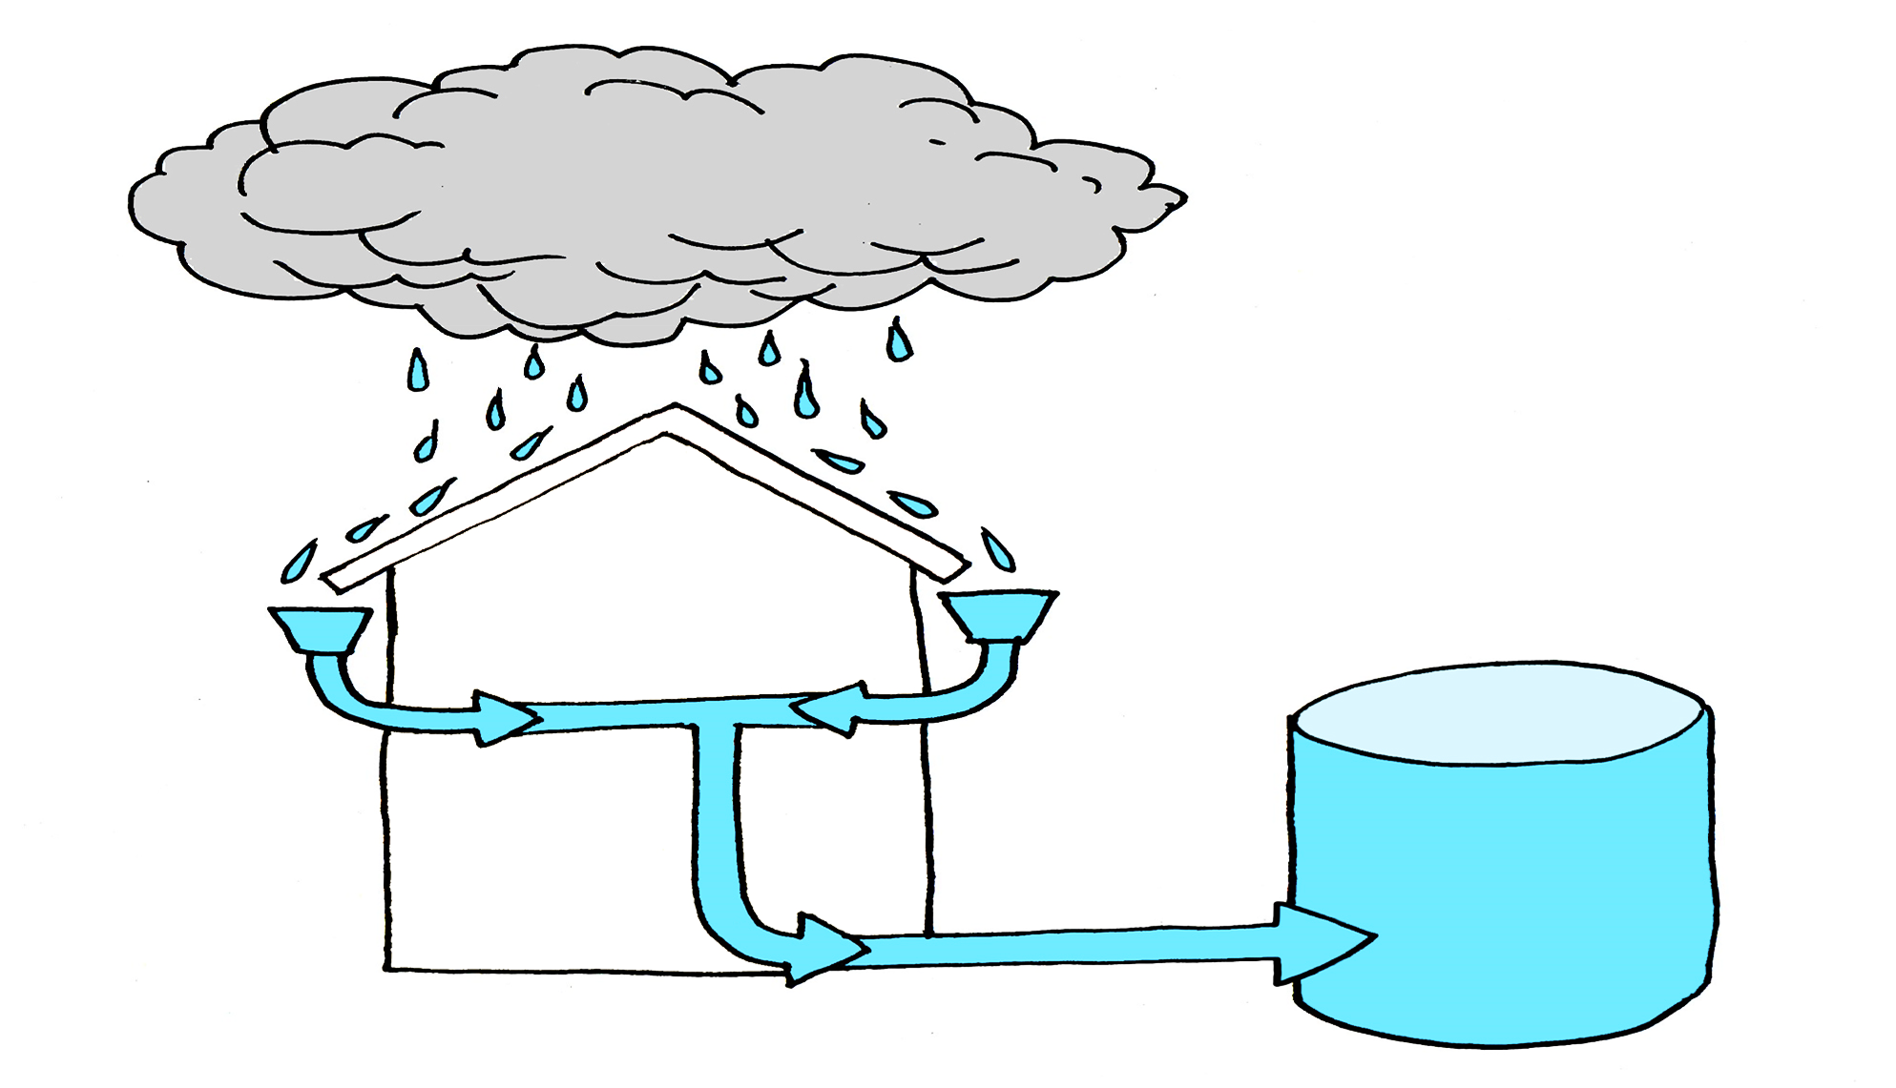
Rain Water Filter
One of the consequences of Climate Change is depleting water levels. This makes its important to harvest and filter rainwater which can help reduce the effects of water scarcity.
“Rainwater harvesting (RWH) is the collection and storage of rain, rather than allowing it to run off. Rainwater is collected from a roof-like surface and redirected to a tank, cistern, deep pit (well, shaft, or borehole), aquifer or a reservoir with percolation.”
Rainwater filters are used to remove material from rainwater as it flows from the collecting roof before it enters the storage tank, and they are crucial to make the water useable. It helps to remove sand, organic matter and some microorganisms.
Removal of this particulate matter, along with oxygenation of the water, greatly reduces the number of harmful bacteria in the tank.

Slide 18
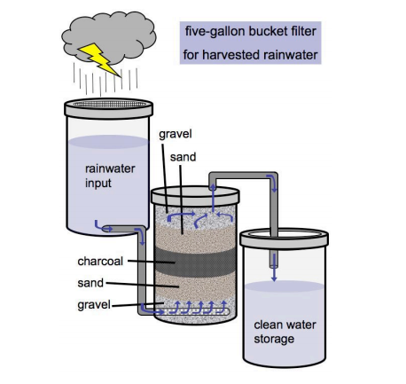
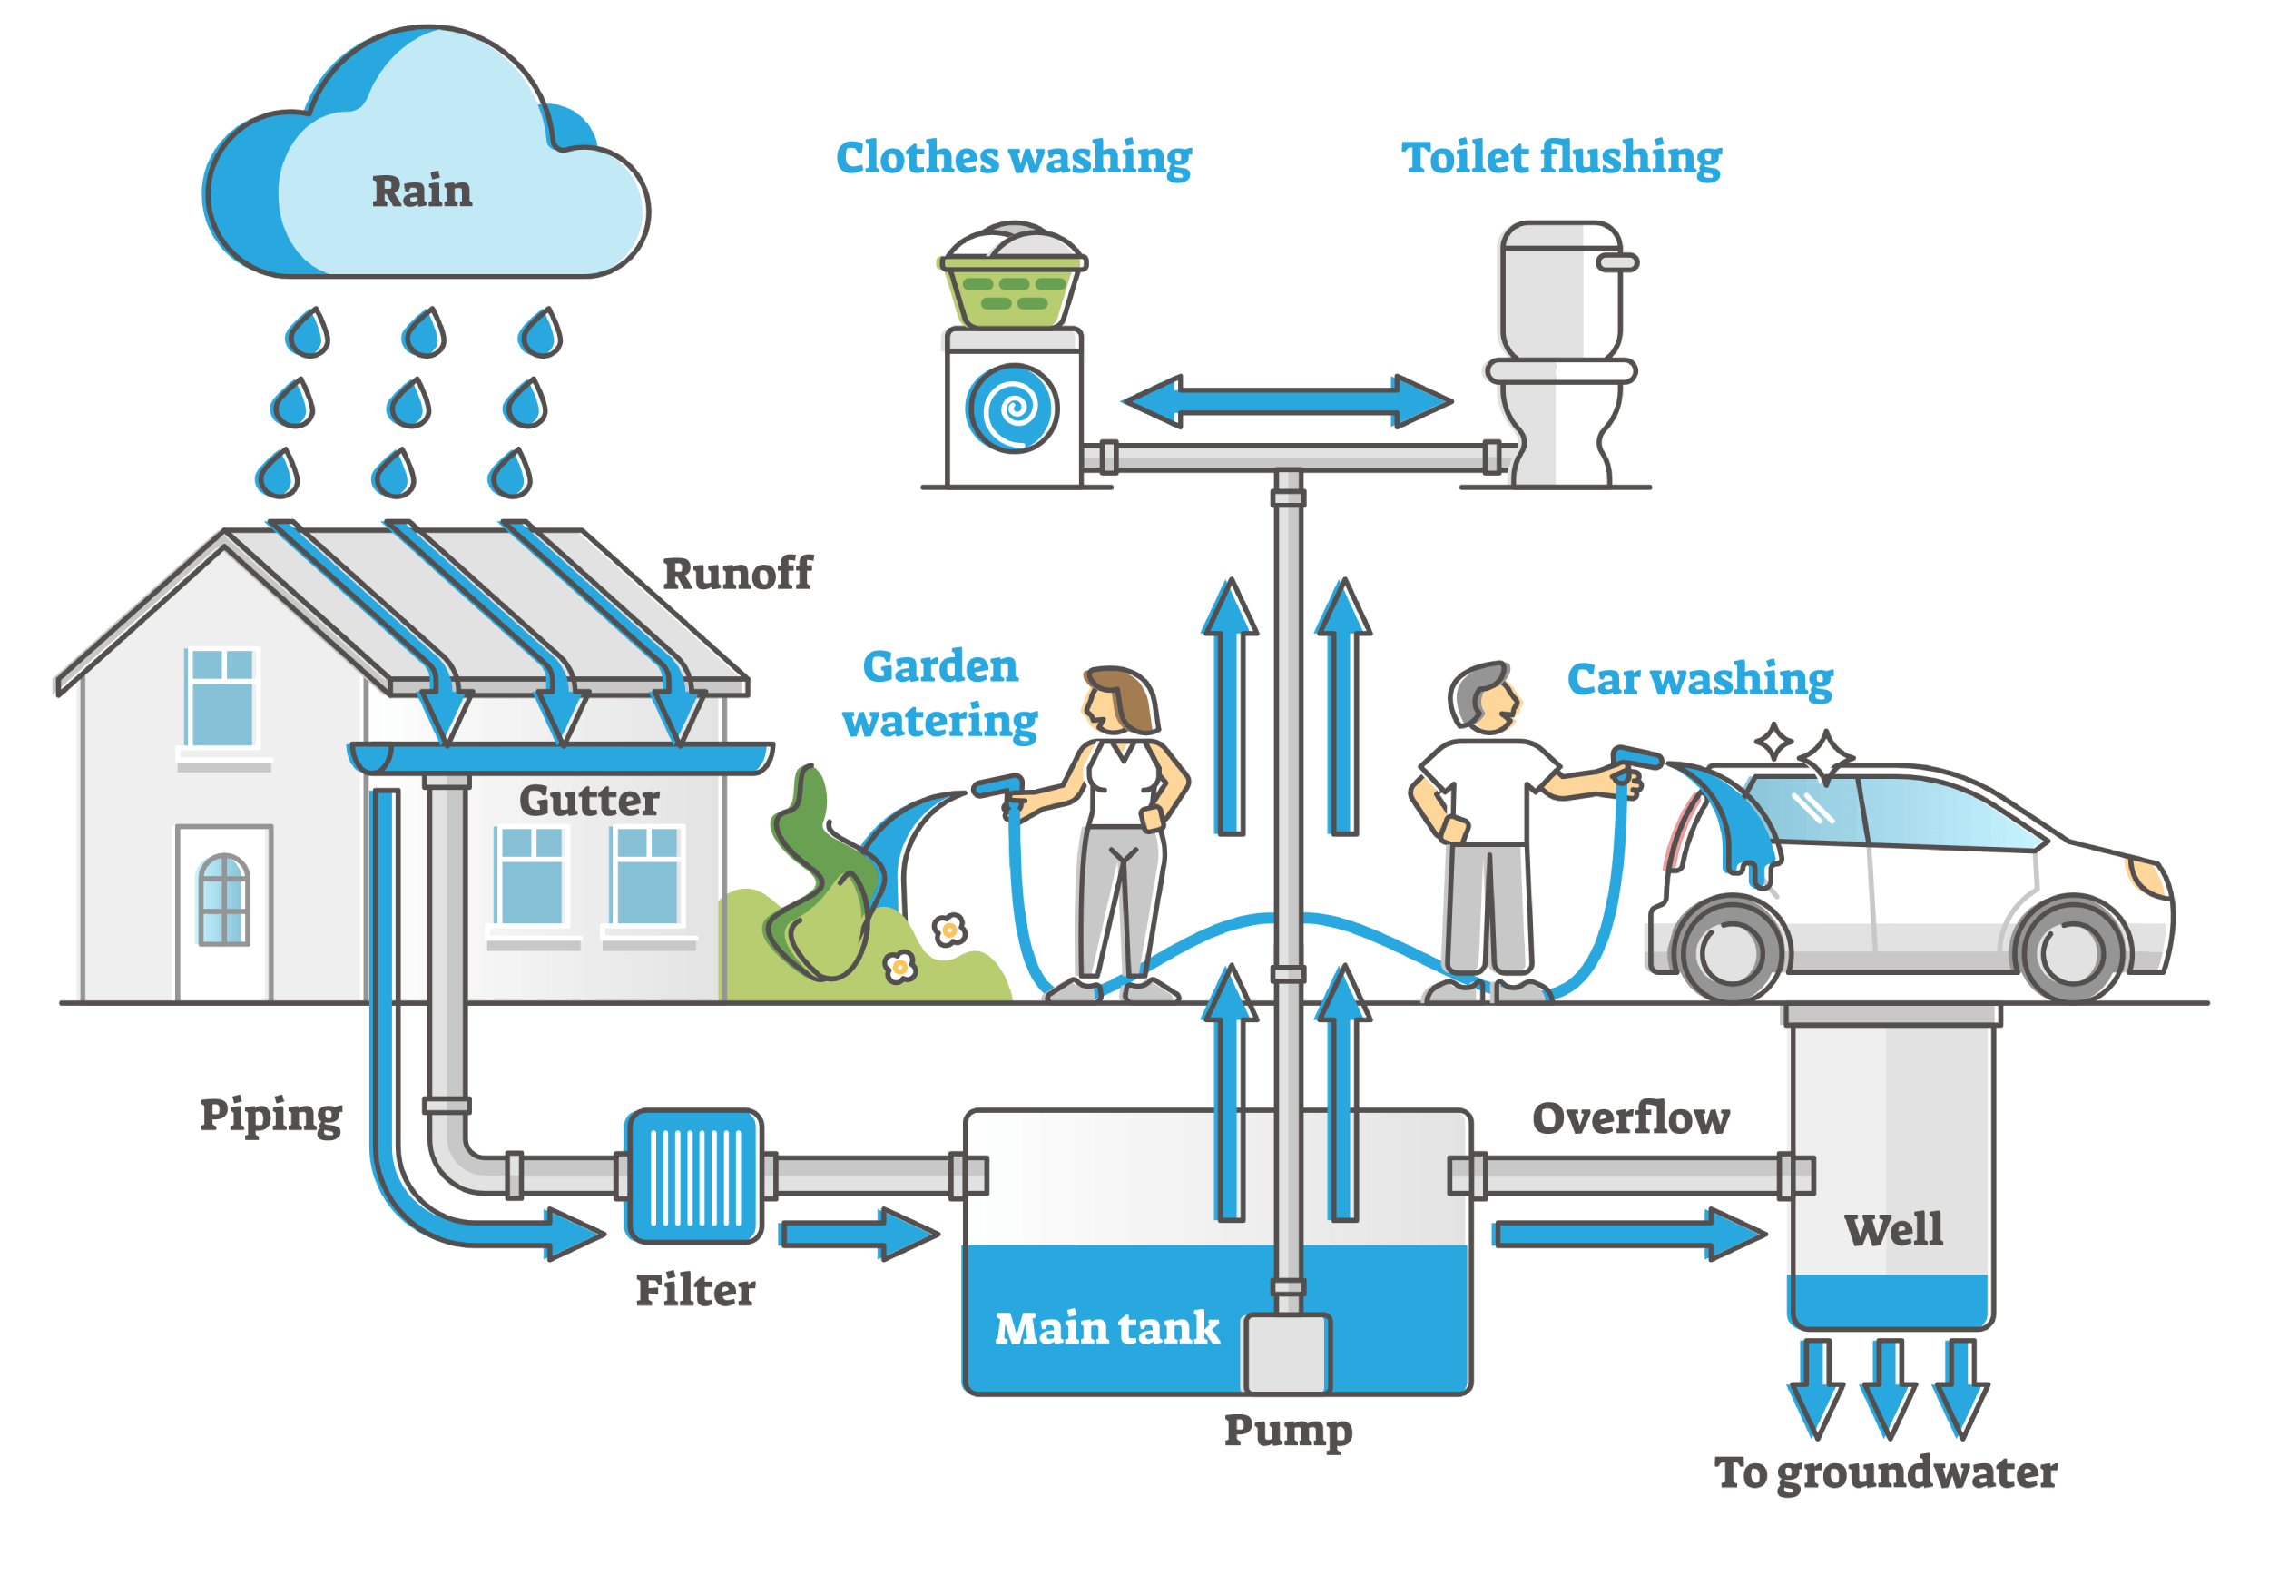
Rain Water Filter

Slide 19
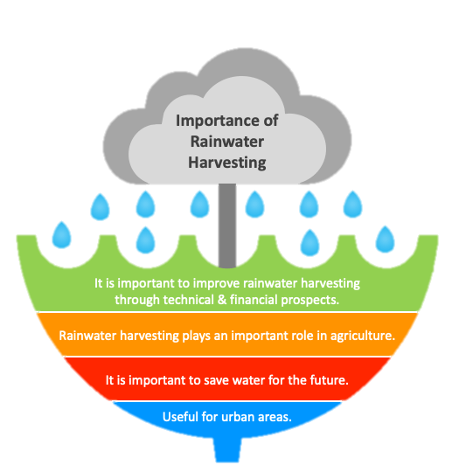
Rain Water Filter
Supplies Needed
Clean Transparent 1-litre bottle
Cotton/ Clean white cloth for filtering
Clean and washed sand
Charcoal (not used)
Pea Gravel
Pebbles
Small stones

Slide 20
Rain Water Filter
Try Yourself

Slide 21
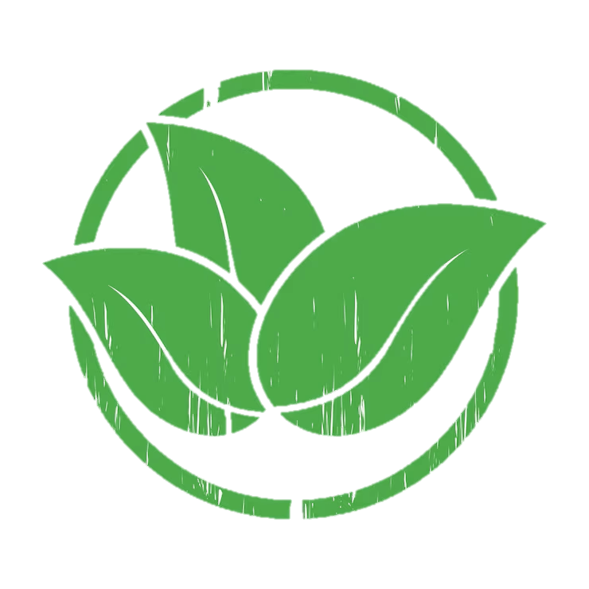
Summary
There are several biobased methods which are sustainable and environment friendly, and if applied at community and national level can help in transforming the economy into bioeconomy.
To achieve this every individual needs to be involved.
Policy Makers across the regions need to be made aware of the different possibilities available and how they can be implemented to benefit the community.
People in the community need to come together to trigger the change towards sustainable development.
Youth need to come forward with innovative ideas that can further make this happen.
So, use your knowledge and skills, let's move towards a Sustainable World.

Slide 22
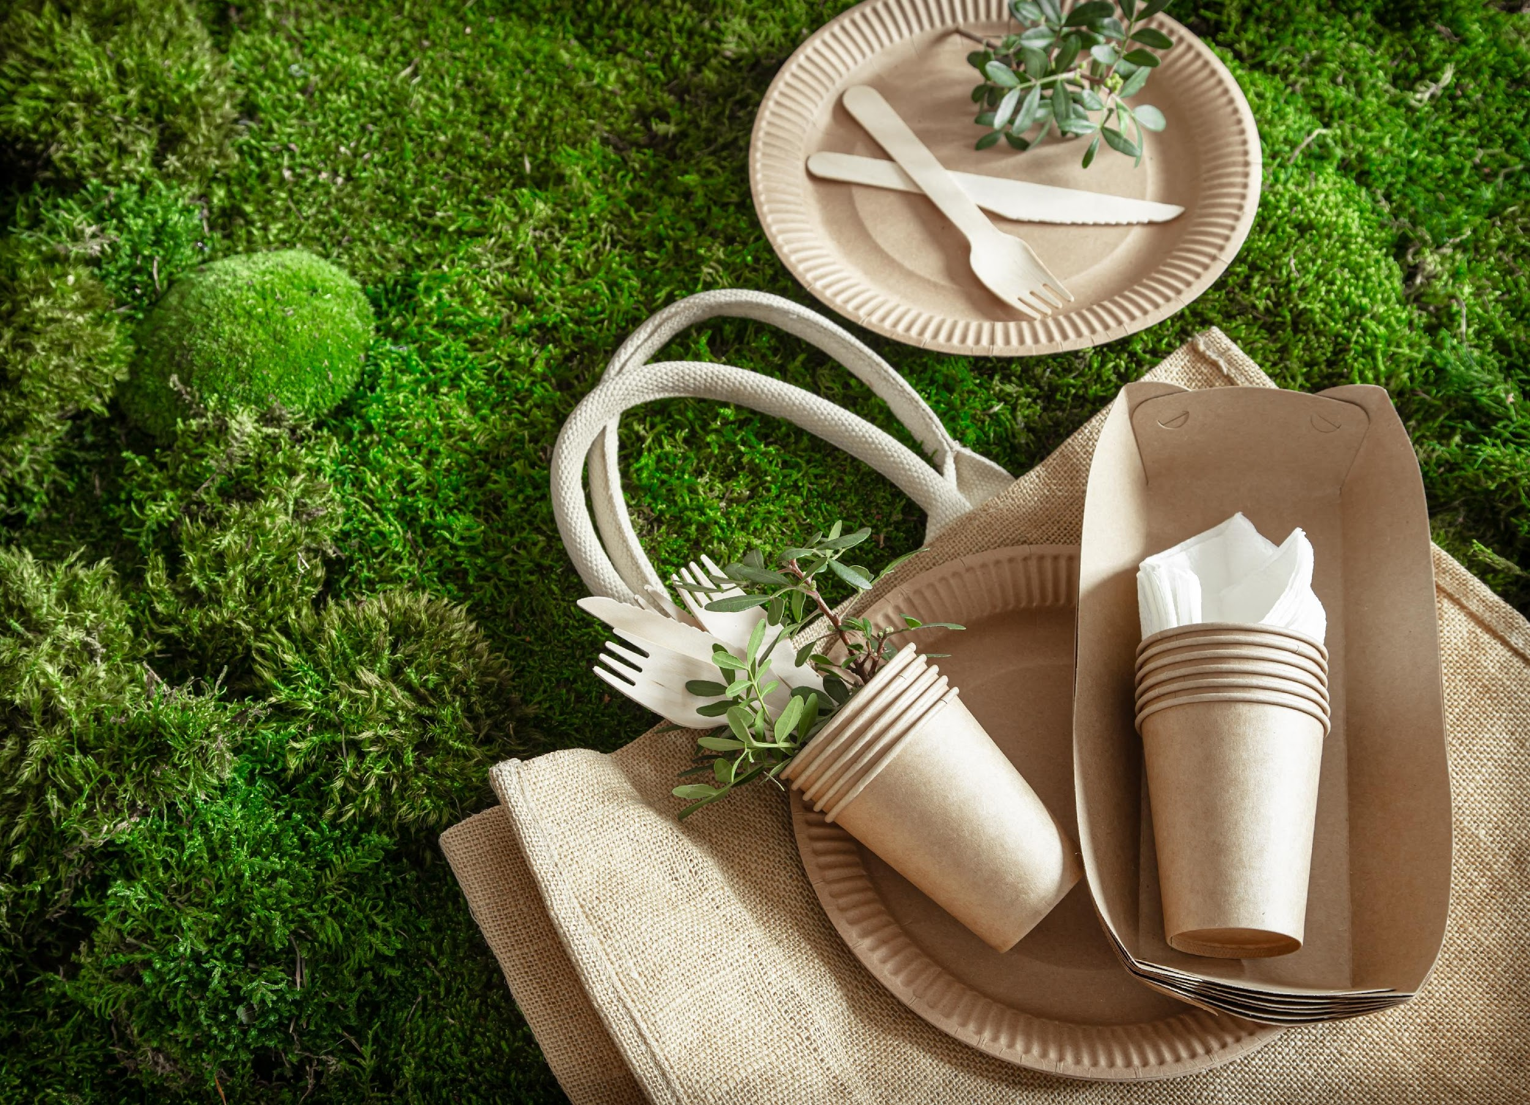
Activity
Implement bio-based ideas at your school or community level, or come up with your ideas about bio-based products and processes that can be implemented in your school or community.

Slide 24
BioBeo Project
Innovative Education for the Bioeconomy www.biobeo.eu

