Slide 1
BioBeo
Bioeconomy Idea Guidelines

Slide 2
Content
What is Bioeconomy?
Advantages of Bioeconomy
Biobased products
Some Examples of Bio-based and recycled products
Creativity Techniques for Generating Ideas
Methods for Communicating Ideas to Policy Makers
Policy Memo
Creating a Policy Memo
Policy Memo Example
Video Pitch
Participating in Open Community Meetings/ Conferences
Some Other Methods
Activity

Slide 3
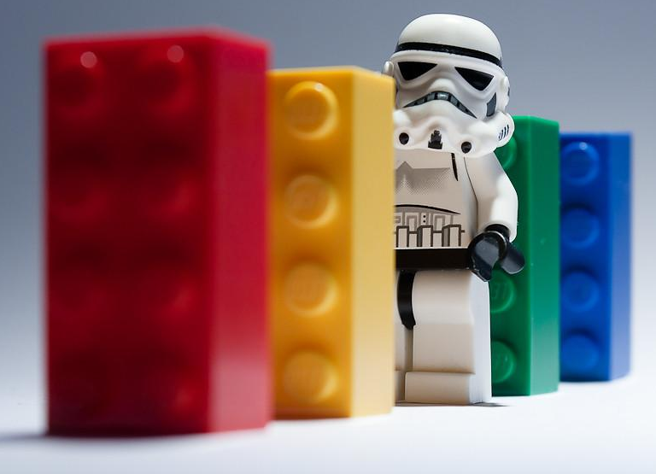
What is Bioeconomy?
Have You played with Lego bricks? You can build all kinds of things with them, like houses, cars, spaceships, and even animals. But did you know that Lego bricks are made from plastic, which is a material that comes from oil? Oil is a natural resource that is buried deep under the ground or under the sea. It takes millions of years to form, and once we use it up, it’s gone forever. Oil is also bad for the environment because it causes pollution and makes the Earth warmer.
But what if we could make Lego bricks from something else, something that is not oil, something that is alive? That’s what bioeconomy is all about. Bioeconomy means using living things like plants, animals, and microbes to make useful stuff like food, clothes, medicine, and energy.
For example, instead of using oil to make plastic, we could use corn or potatoes or algae. These are called bioplastics, and they are better than regular plastics because they can break down naturally and they don’t harm the environment.

Slide 4
What is Bioeconomy?
Bioeconomy is a system-based approach in which fossil resources are replaced by renewable biological resources from terrestrial and marine ecosystems – such as forests, crops, animals, fish, microorganisms, organic waste, and agricultural side streams, to produce food, feed, fibres, energy, bio-based products, and services within a circular economy framework designed to optimise resource use based on cascading hierarchy of utilisation options.

Slide 5
Advantages of Bioeconomy
Bioeconomy enables to solve some of the most important challenges faced by mankind today, almost all of them associated with climate change.
Secure access to food, and lessen desertification.
Sustainable resource management to prevent over exploitation.
Promote renewable energy sources and lessen reliance on fossil fuels.
Create strategies for reducing the effects of and adapting to climate change.
Preserve productivity and competitiveness, while creating green employment.
Decrease greenhouse gas emissions while enhancing public health.

Slide 6
Bio-based Products

Slide 7
Bananatex
Video Link

Slide 8
Avocado Pit Plastic

Slide 9
Used Chopsticks to Products

Slide 10
Rice Husk to Products

Slide 11
Creativity Techniques for Generating Ideas
Morphological Analysis: This is a technique where you break down a problem or a product into different components or dimensions and then combine them in different ways. You can use a table or a matrix to organize your ideas.
For example, you can list different types of bio-based materials (such as corn, sugarcane, potato, algae, etc.) in one column and different types of products (such as bags, cups, utensils, toys, etc.) in another column. Then you can mix and match them to create new combinations. You can also add more columns for other features or criteria (such as colour, shape, size, function, etc.).
Random Word: This is a technique where you use a random word as a stimulus to generate new ideas. You can use a dictionary, a book, a magazine, or an online tool to pick a random word. Then you can try to associate that word with the problem or the product you are working on.
For example, if the random word is “flower”, you can ask: How can I use flowers to make a bio-based product? How can I make a product that looks like a flower? How can I make a product that smells like a flower? How can I make a product that benefits from the properties of flowers?

Slide 12
Creativity Techniques for Generating Ideas
Brainstorming: This is a technique where you generate as many ideas as possible without judging or filtering them. You can use a timer, a word, a picture, or a question as a prompt to start brainstorming.
For example, you can ask: What are some products that can be made from plants or waste? Write down or draw all the ideas that come to your mind, no matter how silly or impossible they seem. You can also do this with a group of friends and share your ideas with each other.
SCAMPER: This is an acronym for seven ways to modify or improve an existing product or idea: Substitute, Combine, Adapt, Modify, Put to another use, Eliminate, and Reverse. You can use these words as questions to spark your creativity.
For example, you can ask: How can I substitute plastic with a biodegradable material? How can I combine two bio-based products to make something new? How can I adapt an existing product to make it more eco-friendly? How can I modify the shape, size, colour, or texture of a product? How can I put a product to another use or solve a different problem? How can I eliminate something from a product to make it simpler or cheaper? How can I reverse the order, direction, or perspective of a product?

Slide 13
Methods for Communicating Ideas to Policy Makers
Do some research and investigation to come up with your ideas that can be implemented in your school and community. With help of one of the following methods, communicate your idea to the Policy Makers in your school or community.
Policy Memo
Video Pitch
Participate in Community Open Meetings/ Conferences

Slide 14
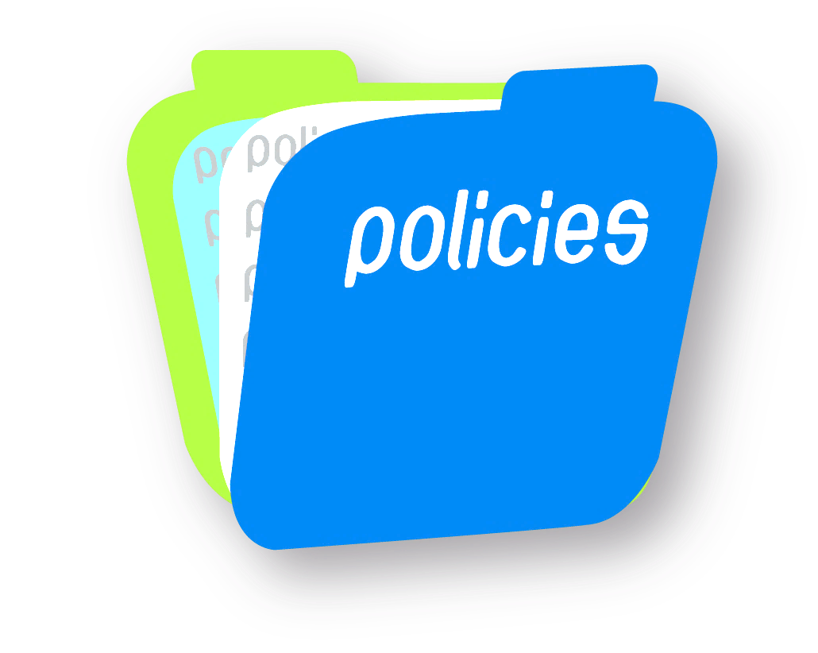
Policy Memo
Bioeconomy is very important because it can help us save the planet and make our lives better. But how can we tell other people about bioeconomy and why should they care? One way of convincing them is to write a policy memo.
A policy memo is a short letter that tells someone important what they should do about a problem.
For example, if you want to convince your school principal to buy biodegradable lunch trays instead of plastic ones, you would write a policy memo to explain why.
A policy memo is a short document that tells someone important what they should do about a problem.
For example, if your teacher asks you to write a policy memo on how to make the school cafeteria food healthier, you would have to do some research and give some suggestions.
But what if your teacher asks you to write a policy memo on bioeconomy?
Well, bioeconomy is a big word that means using living things like plants, animals, and microbes to make useful stuff like food, clothes, medicine, and energy, as mentioned earlier.
For example, you can use corn to make popcorn, but you can also use it to make ethanol, which is a type of fuel for cars. Or you can use cotton to make shirts, but you can also use it to make paper or plastic. Or you can use bacteria to make yogurt, but you can also use them to make antibiotics or biodegradable packaging.

Slide 15
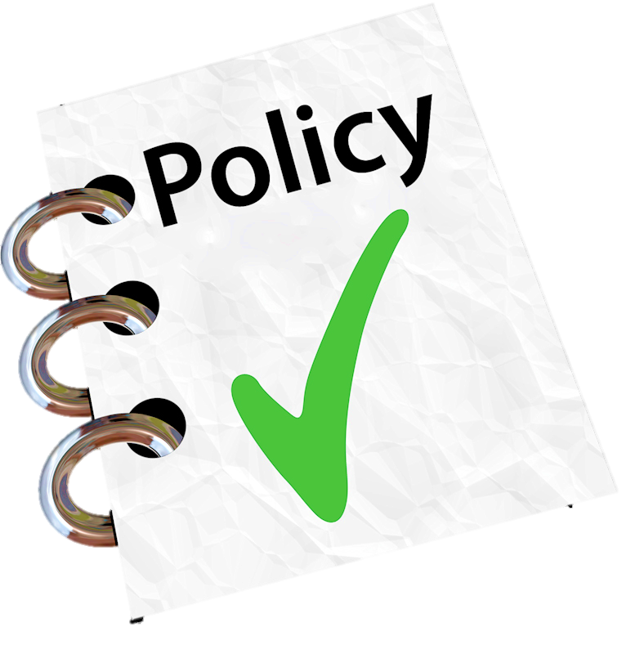
Creating a Policy Memo
So how do you write a policy memo on bioeconomy? Here are some steps to follow:
Think of a problem that bioeconomy can help solve.
For example, maybe you want to reduce the amount of trash in your neighbourhood, or maybe you want to grow more food in your garden, or maybe you want to reduce the amount of plastic waste in the ocean, or maybe you want to increase the production of renewable energy in your country.
Do some research on the problem and the possible solutions. You can use the internet to search for information.
Choose the best solution based on some criteria that matter to your audience. Your audience is the person or group that you are writing the memo for. They could be your teacher, your classmates, your parents, or even the president of your country. You need to think about what they care about and what they can do.
For example, some criteria could be cost, feasibility, effectiveness, environmental impact, social impact, etc.

Slide 16
Creating a Policy Memo
Write your memo in a clear and concise way. A policy memo usually has four parts: an introduction, an issue analysis, a proposed solution, and a recommendation. Here is what each part should include:
Introduction: This is where you introduce the problem and why it is important. You should also state your main message or argument in one sentence.
For example 1: “Plastic waste is a serious threat to marine life and human health, but bioplastics can offer a sustainable alternative.”
For example 2: “Trash is a big problem in our neighbourhood, but we can address this with waste biorefinery that will contribute towards bioeconomy.”
Issue analysis: This is where you explain the problem in more detail and provide some evidence or facts to support your claim. You should also mention the current policies or actions that are being taken to address the problem and why they are not enough or effective.
For example 1: “Plastic waste accounts for about 80% of marine litter and causes harm to animals and humans through ingestion, entanglement, or toxicity. Current policies such as recycling or banning single-use plastics are insufficient or poorly enforced.”
For example 2: “Trash is bad for our health and our environment because it attracts pests, smells bad, and takes up space. Right now, we only have one trash bin in our street and it gets full very quickly.”

Slide 17
Creating a Policy Memo
Proposed solution: This is where you describe your chosen solution and how it works. You should also explain how it meets the criteria that you have selected and how it compares to other possible solutions.
Example 1: “Bioplastics are plastics made from renewable biological sources such as corn starch, vegetable oil, or algae. They have several advantages over conventional plastics: they are biodegradable or compostable, they reduce greenhouse gas emissions and fossil fuel consumption, they have similar or better properties and performance.”
Example 2: “Bioeconomy means using living things to make useful stuff. We can use bioeconomy to reduce our trash by making our own biodegradable lunch trays from corn starch. This solution is cheap, safe, fun, easy, and cool because we can save money, protect our health and environment, learn new skills, and impress our friends.”

Slide 18
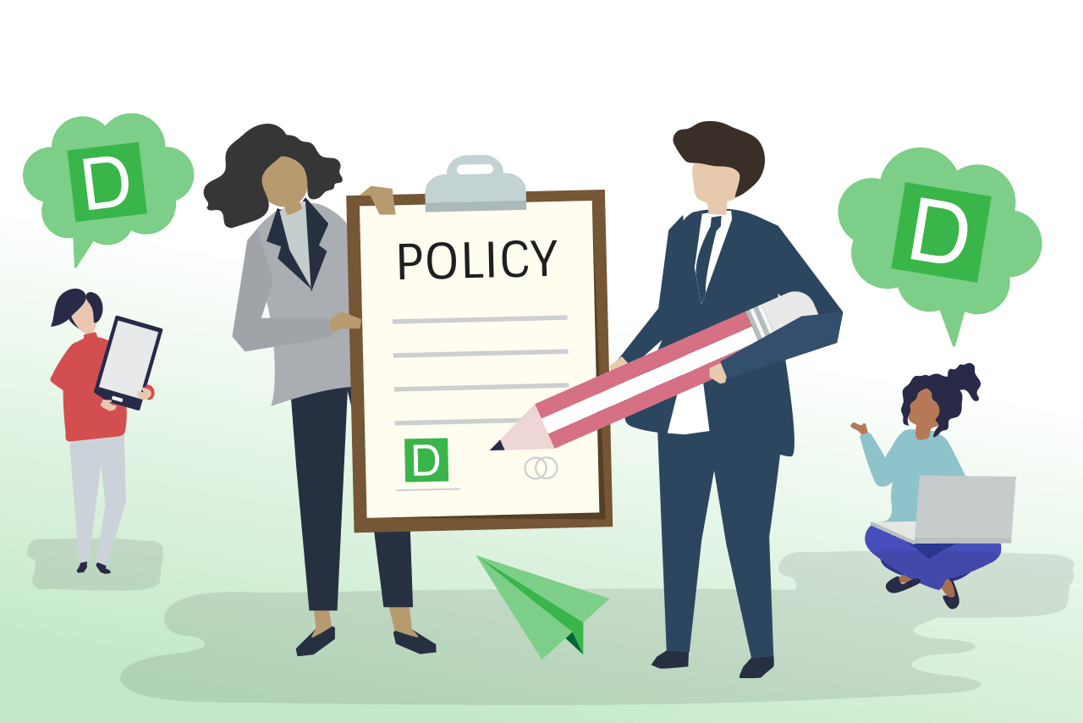
Creating a Policy Memo
Recommendation: This is where you tell your audience what they should do next to implement your solution. You should be specific and realistic about the actions and resources needed. You should also anticipate any potential challenges or objections and address them briefly.
For example 1: “I recommend that the government invests more in research and development of bioplastics and supports their production and use through subsidies, tax incentives, regulations, and public awareness campaigns. Some possible challenges are the higher cost of bioplastics compared to conventional plastics, the competition with food crops for land and water resources, and the lack of adequate infrastructure for biodegradable waste management. However, these challenges can be overcome by improving efficiency, diversifying feedstocks, and enhancing cooperation among stakeholders.”
For example 2: “I recommend that we start making our own biodegradable lunch trays from corn starch as soon as possible. All we need are some cornstarch packets, water, vinegar, food colouring, a microwave oven, and some moulds. Some possible challenges are finding enough corn starch, getting permission from our parents and teachers, and cleaning up the mess. But we can overcome these challenges by asking for donations, explaining the benefits, and sharing the responsibilities.”

Slide 19
Creating a Policy Memo
Format your memo in a professional way. A policy memo should be short and easy to read. You should use headings, bullet points, tables, or graphs to organize your information and highlight the key points. You should also use citations to acknowledge your sources and avoid plagiarism. You can use the citation schema that I have used in the response, or you can follow the style that your teacher prefers.

Slide 20
Policy Memo Example
To: Mayor Tarmo Tamm, City of Spring
From: Kaari Kask, Environmental Activist and Student
Subject: Recommendations for promoting bioeconomy and biodegradable plastics in our community
Date: August 31, 2023
Dear Teet Tamm,
I am writing to you as the member of the Environmental Club at Spring Elementary School. I am very concerned about the environmental problems caused by plastic pollution and I want to do something to help. I have learned about bioeconomy and biodegradable plastics and I think they are great solutions for our community.
What is bioeconomy and biodegradable plastics?
Bioeconomy is the production and use of biological resources (such as plants, animals, microorganisms and waste) to make products and services that are good for people and the planet. Biodegradable plastics are a type of bio-based plastics that can be broken down by living organisms (such as bacteria, fungi and worms) into harmless substances (such as water, carbon dioxide and compost) in a reasonable amount of time. Biodegradable plastics can be made from different sources, such as corn, sugarcane, potato, algae and even food waste.

Slide 21
Policy Memo Example
Why are they good for our community?
Biodegradable plastics have many benefits for our community, such as:
They can reduce the amount of plastic waste that ends up in landfills, oceans and nature, where it can harm animals, plants and people.
They can save energy and reduce greenhouse gas emissions by using renewable resources instead of fossil fuels.
They can create new jobs and businesses by developing new technologies and products based on bioeconomy.
They can improve the quality of our soil and crops by using compost made from biodegradable plastics as a fertilizer.
What can we do to promote them?
I have some suggestions for you to promote bioeconomy and biodegradable plastics in our community, such as:
Support local farmers and producers who use bio-based materials and processes.
Encourage businesses and consumers to use biodegradable plastics for packaging, bags, cups, utensils and other products.
Provide separate bins and collection systems for biodegradable plastics and educate people on how to dispose of them properly.
Invest in industrial composting facilities that can process biodegradable plastics efficiently and safely.
Organize awareness campaigns and events to inform people about the benefits and challenges of biodegradable plastics.
I hope you find these recommendations useful and feasible. I believe that by implementing bioeconomy in our community, we can make Spring a better place for everyone. As Homer Simpson once said: “The answers to life’s problems aren’t at the bottom of a bottle; they’re on TV!” Well, I disagree with him. I think the answers to life’s problems are in nature’s bounty.
Thank you for your attention and consideration.
Sincerely,
Kaari Kask

Slide 22
Video Pitch
Technology has given us powerful tools such as videos that we can create to get the attention of the Policy Makers.
Visual information is often seen as more effective source, compared to reading a document, so creating a short video, pitching your idea, giving data and showing how your idea can be implemented, can sometimes be more effective compared to writing a lengthy document.
To create a Video you can use your mobile devices or a camera if you have one.

Slide 23
Video Pitch
How Should the Video Pitch Be?
Record your video pitch as if you are having a conversation with someone in front of you.
Structure your pitch as a story with Opening, Middle and Closing. Take your audience on a journey, being explicit about what the problem is that you want to solve, and how you intend to do so.
Keep it simple and be compelling without Jargons.
Enhance your pitch with visuals of your solution/ a demo you have already recorded or use slides.
Start strong with a captivating phrase. Deliver your pitch opening with a line that engages your audience and tell your story in short, sharp sentences.
Don’t forget to end well. Ask yourself what lasting impression you want to leave the audience with.
Ensure you have good audio quality while recording.
Choose your recording space carefully. Low ceiling, quiet space and plain background.
Ensure you have sufficient light for recording your video.
Practice before recording and be confident.

Slide 24
Video Pitch
If you want to work on a video pitch on bioeconomy for policy making, you need to be creative and have fun. A video pitch is a way of telling a story about your idea or project, and why it is important and useful for the bioeconomy. The bioeconomy is about using nature’s gifts to make our lives better, such as food, fuel, and materials from plants, algae, and waste. Here are some steps on how to make an entertaining video pitch on bioeconomy for policy making:
Choose a topic that you are passionate about and that relates to the bioeconomy. For example, you could choose to talk about how to make clothes from mushrooms, how to grow food in space, or how to turn plastic waste into art.
Do some research on your topic and find out some facts, benefits, and challenges of your idea or project.
Write a script for your video pitch that covers the following points:
What is your idea or project and why is it important for the bioeconomy?
What are the advantages and disadvantages of your idea or project?
What are the actions and recommendations that you suggest for implementing your idea or project?
How can your idea or project contribute to the Sustainable Development Goals (SDGs) and the Paris Agreement?
How can you persuade your audience to support your idea or project?

Slide 25
Video Pitch
Record your video using a camera, a microphone, and a computer. You can use different tools and techniques to make your video more attractive and effective, such as:
Use a clear and confident voice and a friendly and enthusiastic tone.
Use simple and understandable language and avoid jargon and technical terms.
Use visuals, such as graphs, charts, images, or animations, to illustrate your points and make them more memorable.
Use humour, creativity, and originality to make your video more fun and engaging. For example, you could write a poem, a song, a code, or a parody to summarize your video pitch or to highlight its main recommendations.
Edit your video using a software or an app that allows you to cut, trim, merge, or add effects to your video. You can also add music, sound effects, subtitles, or transitions to your video. You can use different tools and platforms to edit your video, such as iMovie, Windows Movie Maker, YouTube Studio, or TikTok.
Share your video with your target audience and get their feedback. You can use different channels and platforms to share your video, such as email, social media, websites, or online events. You can also ask for comments, ratings, likes, or shares from your audience. You can use their feedback to improve your video or your idea or project.

Slide 26
Video Pitch Example

Slide 27
Video Pitch Example

Slide 28
Paper from Banana Plant Stem

Slide 29
Video Pitch
Tips

Slide 30
Participating in Open Community Meetings/ Conferences
Alternatives to writing Policy Memos, Policy Brief and Creating a Video is to present your ideas in person to the Policy Makers by attending Open Community Meetings/ Conferences.
At times, these types of events are published in local newspapers or the website of the local government agencies along with the topics to be covered.
To present your ideas during these kinds of events, you need to prepare all the information and relevant points in relation to the topic you want to present.
Ensure you talk to organisers of the meeting/ conference, so that they allot you a time slot for your presentation.
Ensure that the timing of your idea is relevant and suitable for the meeting topic.
If you need to do a demonstration, have all you need at hand.
Another way of presenting your idea in open to Policy Makers is by participating in local/ regional innovation and policy challenges. These types of challenges also assign mentors/ supervisors who help to fine tune ideas and are very informative.

Slide 31
Some Other Methods
As long as your Idea is sustainable, scalable and helpful to the community, you can use methods such as:
Creating infographics/ brochures and distributing them in your community, providing relevant information and details for the community members to understand and implement.
Creating a website and promoting it in your community or social media.
Similarly, you can start a campaign, so that more people can support your idea to seek the attention of the Policy Makers.

Slide 32
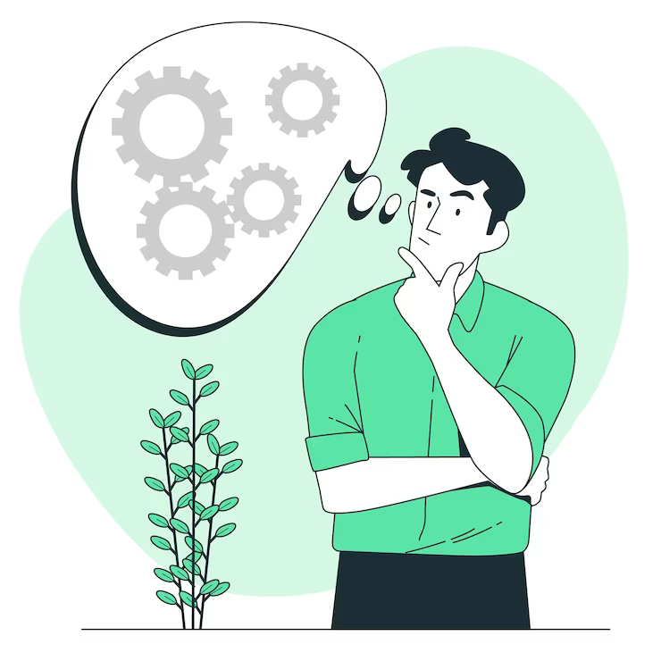
Activity
Get Inspired.
Use one of the idea generating techniques and come up with a solution to a problem in your school/ neighbourhood that can be solved using bio-based products. Communicate that idea with policymakers in your area/ school.

Slide 33
BioBeo Project
Innovative Education for the BioEconomy

