Slide 1
BioBeo
Creativity Techniques

Slide 2
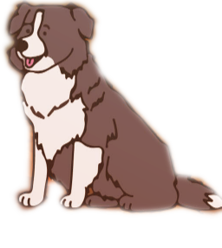
Content
What is Creativity and where does it come from?
Rules of Creativity World
Why is Creativity important and what does it contribute to?
What does Creativity depend on?
How to develop Creativity?
Creativity Techniques
Food for Thought

Slide 3
What is Creativity?
Tendency of an individual to create new ideas, alternatives, possibilities that may be helpful in solving problems.
According to Albert Einstein “Creativity is intelligence having fun”
It can be as simple as using leftover pizza toppings to make a sandwich with a smiley face ☺ Or
It can be an artwork created by using plastic.
Creativity can be seen in everything – songs, videos, paintings, games, dance, projects, and much more.

Slide 4
Where does Creativity come from?
Found in your head and mine.
Scientists state it as a product of brain’s right hemisphere.
Often a result of experimenting, exploring, questioning assumptions, using our imagination, dreams, and experience from world around us.

Slide 5
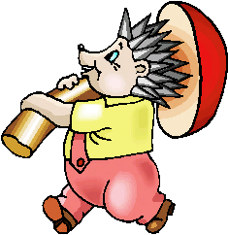
Rules of Creativity World
There are no rules in creativity world.
The treasures in creativity world are endless and unusual.
The treasures in creativity world are found outside the box.
The fortunes of creativity world must be carefully recorded, so that they can be combined into a large fortune.

Slide 6
Why is Creativity important and What does it contribute to?
Creativity engages the mind.
Creativity frees the mind in a way that enables a person to absorb knowledge more easily. It makes processing learning, more efficient.
Creativity enables alternative ways of thinking. It opens the mind.
Creativity unblocks old patterns or habits of thinking. It allows for non-linear thinking.
Creativity enables empathy.
Creativity connects us to ourselves.
Creativity keeps the mind active.
Creativity engages different learning styles.

Slide 7
Why is Creativity important and What does it contribute to?
Creativity challenges.
Creativity can connect reflection with action.
Creativity nurtures confidence.
Creativity instils curiosity. It encourages questions.
Creative expression gives a voice. It can help capture ideas, thoughts and visions about the world. Young people can advocate for themselves and for others.
Creativity is participatory and interactive.
Creativity stimulates and motivates.
Creativity brings us beyond words.

Slide 8
What does Creativity depend on?
Concepts
Ideas
Imagination
Problem Solving
Thoughts

Slide 9
What does Creativity depend on?
Components of Creativity
Expertise
Motivation
An inner passion to solve the problem at hand leads to solutions far more creative than do external rewards, such as money. Intrinsic motivation is the one that can be mostly immediately influenced by the work environment.
Technical, procedural, and technical knowledge
Creativity
Creative-thinking Skills
Determine how flexible and imaginatively people approach problems.

Slide 10
What does Creativity depend on?
Sternberg's 5 Components of Creativity
Expertise – A well developed base of knowledge.
Imaginative thinking skills – provide the ability to see things in novel ways, recognise patterns and to make connections.
Venturesome personality – Seeks new experiences, tolerates ambiguity and risk, perseveres in overcoming obstacles.
Intrinsically Motivated – driven more by interest, satisfaction and challenge than by external factors.
Creative Environment – Sparks support and refines creative ideas.

Slide 11
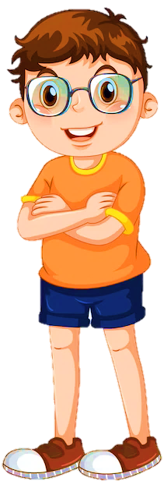
What does Creativity depend on?
Individual Differences
Adaptor
Employs disciplined, precise, methodical approach.
Is concerned with solving, rather than finding problems.
Tends to be means oriented.
Is capable to extend detailed work .
Is sensitive to group cohesion and cooperation.
Innovator
Approaches task from unusual work.
Discovers problems and discovers avenues of solutions.
Questions basic assumptions related to current practices.
Has little regard for means.
Has little tolerance for routine.
Has little or no need of consensus; often insensitive to others.

Slide 12
7 Innovation Myths
Breakthroughs come from ideas that are unique.
Inventors make scientific breakthroughs.
The world runs into a “right mousetrap”.
All good ideas come from small people.
Great success requires great resources.
A breakthrough needs a special environment.
Breakthrough products always meet an unmet need.

Slide 13
How to Develop Creativity?
“People are not born creative, but rather their development of, set of attitudes towards life, characterises which way they will go.”
Believe in yourself and commit to developing creativity.
Our ability "to do" and "to learn" is influenced by our belief system operated by our mind, which is an amazing machine. If we tell ourselves that we are creative and can come up with ideas, we won't put any mental barriers in the way of coming up with great ideas. The right half of our mind gives the ability to produce thoughts, assuming that we just use and exercise it. Therefore, set goals and devote yourself to developing creativity.
Start identifying your own ideas first.
When you need ideas or solutions, try not to turn to the creative people you might have relied on in the past. Take some time to think of your own ideas and solutions first. Your imagination will naturally grow as a result of this.

Slide 14
How to develop Creativity?
Start interacting with creative people
People who are creative often have the ability to imagine what might be, and interacting with them can lead to new ideas and perspectives. Search for individuals who are enjoyable to converse with and have a sharp feeling of interest throughout everyday life, a person whose interactions with you will force you to think creatively. Conversing with many individuals from various disciplines, foundations, societies and encounters will assist you with seeing things according to alternate points of view and foster your creative mind.
Engage with younger children
Pre-school kids are the best to blend in with, as they by and large utilise the two sides of the cerebrum despite the fact that inclinations really do begin to frame at an early age. If you interact with them and look into their world and how they see everyday things, your world will also be filled with fantasy.

Slide 15
How to develop Creativity?
Solve puzzles, play games or sports
Certain games and riddles can provide you with a lot of chance to utilise your innovative powers. Games drive you to delineate systems and take actions that rely upon what your rival does. Examples include chess and checkers, as well as physical sports like football, basketball, and tennis, all of which encourage creativity.
Have hobbies
Find or take up a hobby to get creative. Obviously, taking up a hobby like painting, drawing, or sculpting will help you express your creative side. Sewing, metalworking, woodworking, and DIY are just a few of the hobbies that require you to design something entirely from scratch. However, technical hobbies can provide creative exercise for those with a stronger interest in science by allowing them to design or build something new, such as writing new computer programs.
Travel
Active travel is the best way to broaden and refresh your perspective. This means really getting to know the people and the culture of the place you're going. Great ideas can come from documenting your travels with photographs and reflecting on those experiences.

Slide 16
How to develop Creativity?
Read selectively
Reading selectively implies picking materials that will help train your creative mind. One method for practicing your creative mind with brief tales is to peruse the primary half and make up your own assumption. Cookbooks, fix manuals and self improvement guides can likewise be utilised for innovative activity in the event that you take the thoughts introduced and further develop them by adding, adjusting or consolidating them with thoughts of your own.
Read actively
This requires you to read with a pencil in your hand and highlight important passages as you go. By reading slowly and taking notes, you can spend more time reflecting on what you've read and increase your chances of coming up with new ideas. As you read, for instance, to develop your thinking, make a mind map.
Start creative writing
A great way to improve your ability to think creatively is to write short pieces on topics that you are interested in or worry about. You may then feel great to allow your creative mind to meander to compose a brief tale.

Slide 17
Creativity Techniques
Creative Techniques are tools used to produce plenty of thoughts on the best way to tackle a given issue. By "thinking outside the box," they typically aid in expanding the scope of potential solutions and generating truly novel concepts. Creativity techniques can be approached in two ways:
Random Method’s | Systematic Method’s
Any word, Another point of view, rewording… | Metaphors, List of features, Matrix Analysis, Visions of the future, TRIZ (Inventor’s Aid Questions)…
Free from specific information needs Based on human cognition There are no evaluation criteria's | Functions with more specific information Less feelings, more system Involves taking advantage of previous experiences

Slide 18
Creativity Techniques
Random Method
The solution
Different thinking
( avoid restrictions )
Search space
Search space
Systematic Method
Different thinking
( avoid restrictions and use navigation )
The solution
Search space
Search space

Slide 19
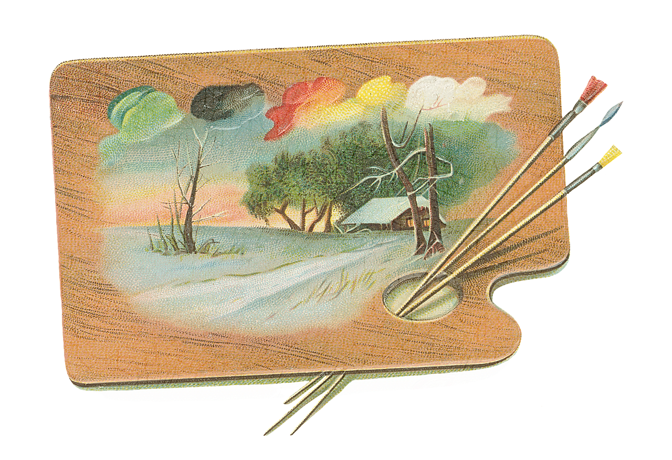
Creativity Techniques
There are several techniques for creativity, each involving different creative ways to think creatively. Here are some, you can look up others. Don’t restrict yourself to these.
Brainstorming
Brainstorming by Analogies
Brainwriting 6-3-5
Pictures as Idea Triggers
Morphological Chart
Six Thinking Hats
Five W’s and one H
Random Words
Mind Mapping
Lateral Thinking
SCAMPER

Slide 20
Creativity Techniques
Brainstorming
Brainstorming consolidates a relaxed, casual way to deal with critical thinking with lateral reasoning. It urges individuals to concoct idea and thoughts that can, from the start, appear to be impractical. Some of these concepts have the potential to be developed into original, inventive solutions to a problem, while others have the potential to generate even more concepts. This allows people to use each other's ideas to jolting their thinking, and helps to get out of their normal thinking, by making them unstuck to look beyond.
It’s can be used for mostly all kinds of groups.
When brainstorming, everyone is encouraged to participate in a free and open environment. All participants are encouraged to fully contribute, which aids in the development of a wide range of inventive solutions, and unconventional concepts are encouraged and built upon.
The typical time is between thirty and one hour. can be shorter or longer, depending on how hard the problem is and how motivated the group is.

Slide 21
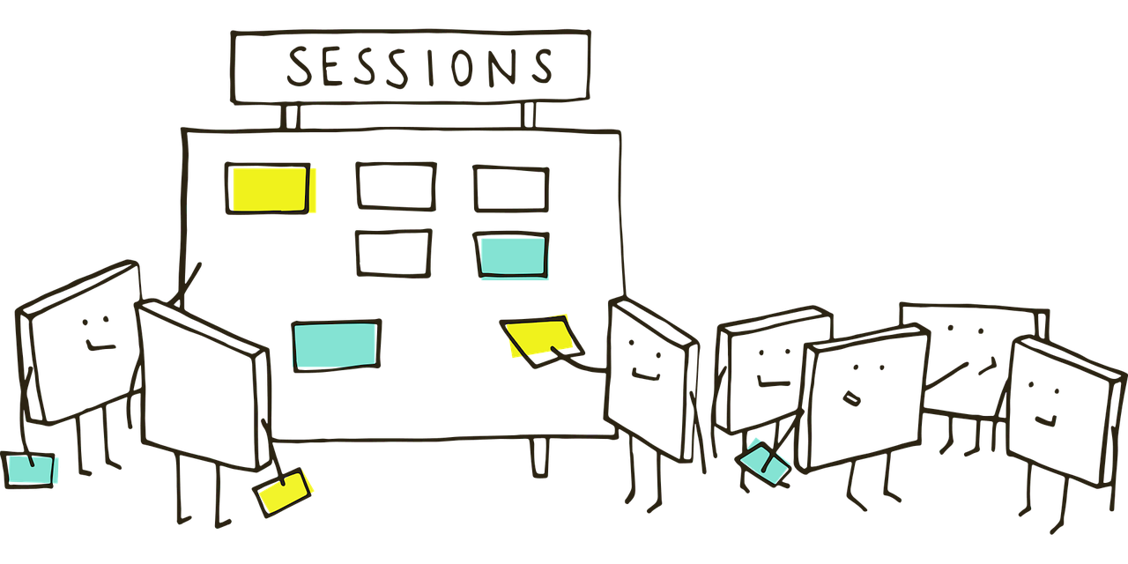
Creativity Techniques
How to Use Brainstorming
Prepare the group – Set up the group and explain what needs to be done.
Define the Problem – Make sure everyone understands the issue for which ideas are needed by describing it. It is very simple for people to take the wrong path. This can be accomplished effectively by writing it down on a flipchart page and gluing it to the wall.
Generate Ideas – Allow the group to create ideas. Keep the ideas visible to trigger further ideas by writing them on flipchart.
No criticism or Debate – Just take in whatever ideas come up
Quantity over Quality – More ideas the better
Freewheel – using one idea as a stimulus for the next.
Mutate and Combine – deliberately distort and modify existing ideas and deliberately try to build new ideas from the combinations of existing ones.
Reduce Ideas – Separating and Selecting Ideas is Idea Reduction.

Slide 22
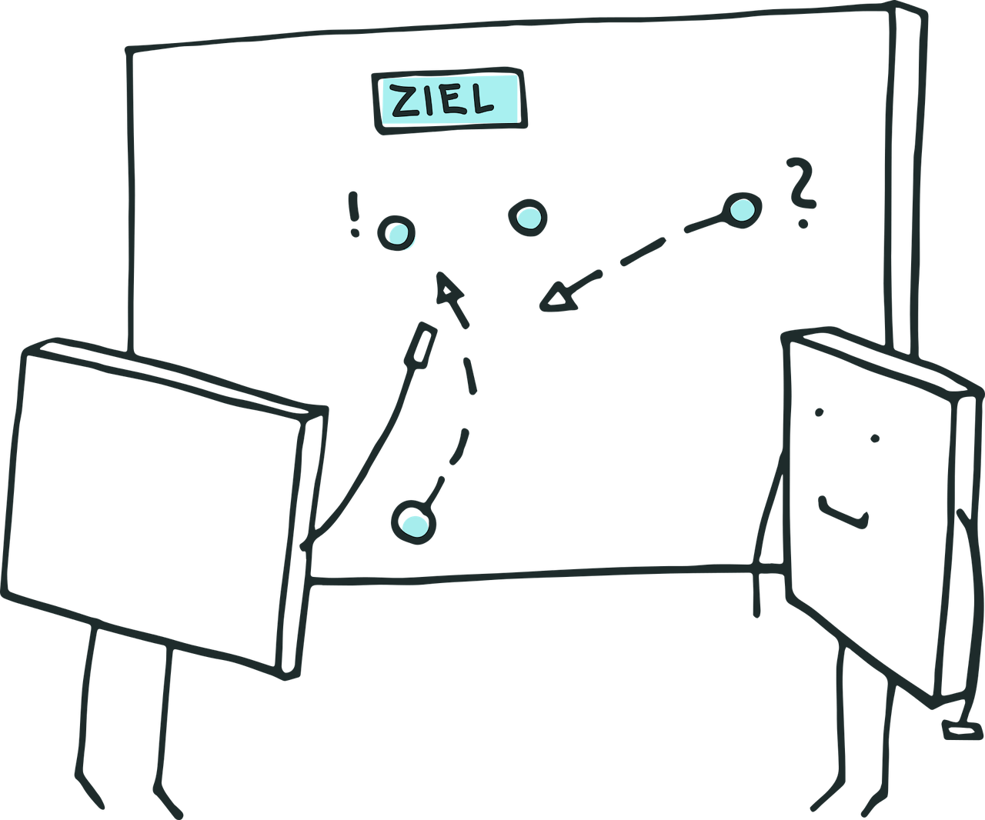
Creativity Techniques
Brainstorming by Analogies
When you state that something is similar to something else (in some ways but not in others), you are using an analogy. For instance, a jumbo jet and an albatross are similar in that they both fly, have wings, can go great distances without stopping, and can sense where they are going; nevertheless, they differ in that they use various propulsion systems, are constructed from various materials, etc.
Many methods for fostering creativity include analogies as a major component. An informal way of using an analogy is to say, "This problem makes me think of X (analogy), which suggests to me that maybe we could try Y (idea derived from analogy X)."

Slide 23
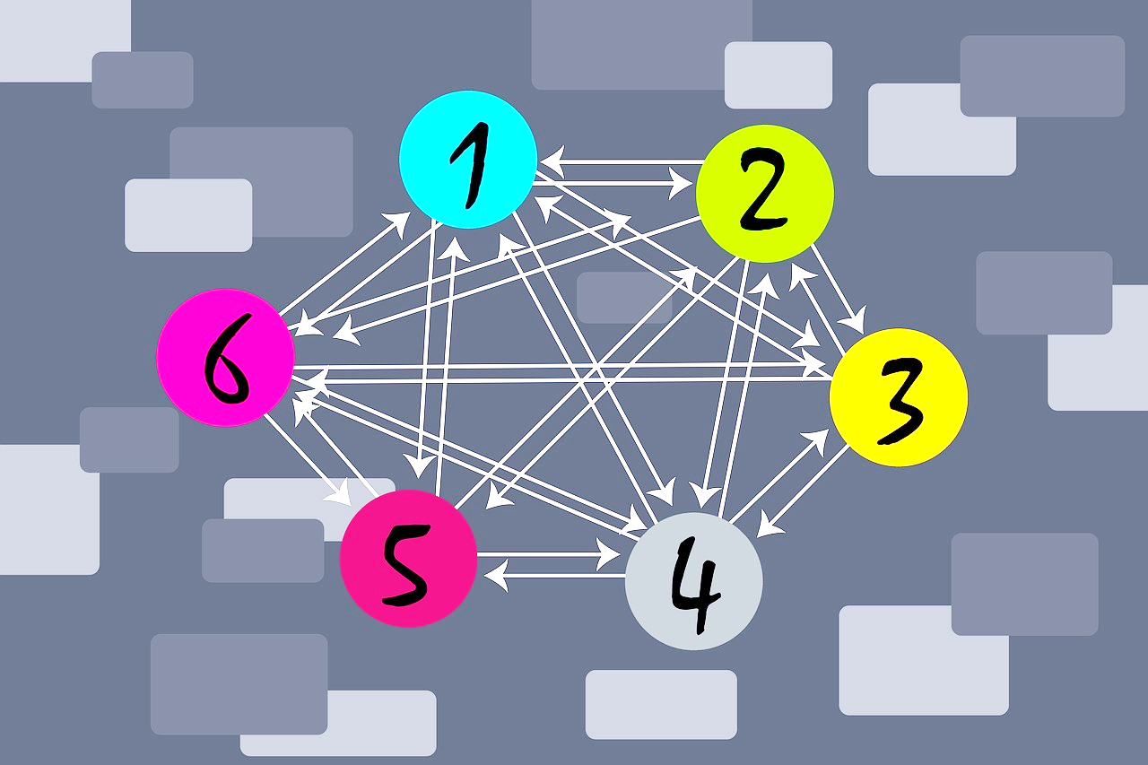
Creativity Techniques
How to Use Brainstorming by Analogies
Define the nature of idea – Define what you want to think about and try looking for a basic word phrase, such as: "How to create X", that reflects the essential functional nature of your search. 'How to avoid Y', 'How to accelerate Z', 'How to improve A’.
Generate a List – Create a list of everything that is "like" each verb phrase in some manner, such as comparisons to "making X" (having a baby, creating pudding, the Genesis creation myth, a robot car factory, etc.).
Pick One – Choose an analogy that appeals to you, particularly one where the verb phrase and comparison come from separate fields, such as a biological analogy for a mechanical issue.
Describe – Describe the analogue, mentioning both passive (size, position, etc.) and active (such as how it operates, what it does, the impacts it has, and how it is utilised) elements.
Suggest Ideas – Use this description to get suggestions for solutions to your issue. Are there functionalities on the analogy that you can utilise right away? Do the differences suggest other ways of looking at your problem?

Slide 24
Creativity Techniques
Brainstorming by Analogies can be:
Close/ Direct: A close or direct comparison, such as "selling science is like selling baked beans" or "the human arm is like an Anglepoise lamp," is a functional analogy.
Fantasy: Imagine you were to solve it in your wildest imagination or in another cartoon or fantasy universe. What image would you have in mind?
Remote and/or surprising: Selling widgets is like directing an elephant. Although the similarities they imply are unlikely to have any "rational" status, they are more likely to question preconceptions and lead to fresh discoveries and ideas. When taken to the limit, they combine to form the utilisation of random stimuli.
Personal / component: In this case, you join the system as a component. Thinking as if you are the tip of a shell yourself, if you are trying to figure out how to make shells hit the target more precisely.

Slide 25
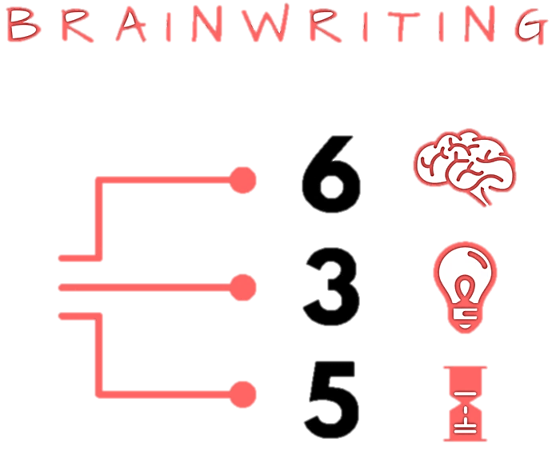
Creativity Techniques
Brainwriting 6-3-5
The process of six people writing three ideas in five minutes.
In particular, for groups of people who are somewhat reluctant and can't provide a lot of ideas at an open group session like Brainstorming, Brainwriting is very helpful.
It is also helpful when each one of us has a problem which he or she wishes to solve.
It's very well suited to large groups, and it doesn't really impose any limits on group size.

Slide 26
Creativity Techniques
How to Use Brainwriting 6-3-5
Provide Material – Give out sheets to 6 people, with a place for a problem statement at the top and rectangles for ideas to be typed in. On a single sheet of paper, arrange rectangles in as many rows as possible. Make the rectangle's empty area large enough to hold an average proposal.
Identify the Problem – At the top of the page, each person writes a problem. It's different for each person, and it's different for everyone, for example, if you're all concerned with the same problem. If these ideas are for an individual, they can write their name on the page so that it finds its way back to them.
Write Ideas – Now each individual hands the page to a companion who records 3 solutions to the issue on it in 5 minutes.
Keep going until you are done – The sheet will be handed over to another person who adds even more ideas, and if possible uses what is currently existing as a stimulus. The sheets shall be passed back and forth as long as they are full. When a page is completely filled, you can add more sheets or stop.
Assess the ideas – Narrow down ideas from the 6 pages depending on the problem statement.

Slide 27
Creativity Techniques
Brainwriting enables people who have ideas but are concerned about voicing them in a broader group to make them visible anonymously. Therefore, it is not necessary for them to "compete" with others in order to be heard. It's also important that all ideas are visible and that they can be easily scanned to generate new ideas. That's because everyone offers ideas constantly, so it can speed things up.

Slide 28
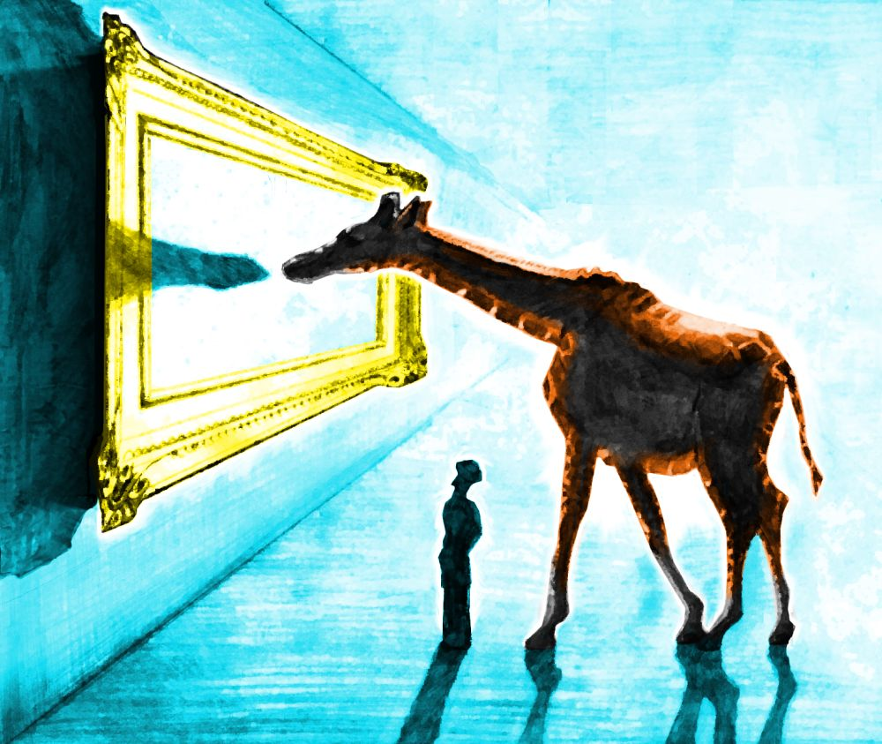
Creativity Techniques
Pictures as Idea Triggers
Pictures can be a powerful tool for triggering ideas and stimulating creativity. When we see an image, our brain immediately begins to process it and make associations with other concepts, memories, and emotions. These associations can spark new ideas and insights that we might not have considered otherwise.
Pictures can also help us to break out of our usual patterns of thinking and see things from a fresh perspective. For example, if you're stuck on a problem or idea, looking at a picture of a related concept or a completely unrelated subject could help you make connections and generate new ideas.
Additionally, pictures can evoke strong emotions and create a mood or atmosphere that can inspire creativity. A beautiful landscape, an interesting character, or a striking abstract image can all elicit different feelings and ideas.
Overall, pictures can serve as powerful sources of inspiration and idea triggers, allowing us to tap into our imagination and explore new possibilities.

Slide 29
Creativity Techniques

Slide 30
Creativity Techniques
Pictures for Ideation can be used in several ways:
Visual brainstorming: Start with a picture that relates to the problem or idea you're working on, and use it as a starting point to generate new ideas. Write down all the ideas that come to mind as you look at the picture.
Mood boards: Collect a group of pictures that represent the mood, atmosphere, or style you want to convey in your project or idea. This can be helpful for visualizing and communicating your vision to others.
Image association: Choose a picture and make a list of all the words, concepts, or emotions it evokes. Then, use those associations to generate new ideas or connections.
Random picture generator: Use a random picture generator tool to generate a random image and use it as a prompt for generating new ideas. This can be a fun and unexpected way to spark creativity.
Overall, pictures can be a versatile and effective tool for generating new ideas and exploring creativity in a visual and intuitive way.

Slide 31
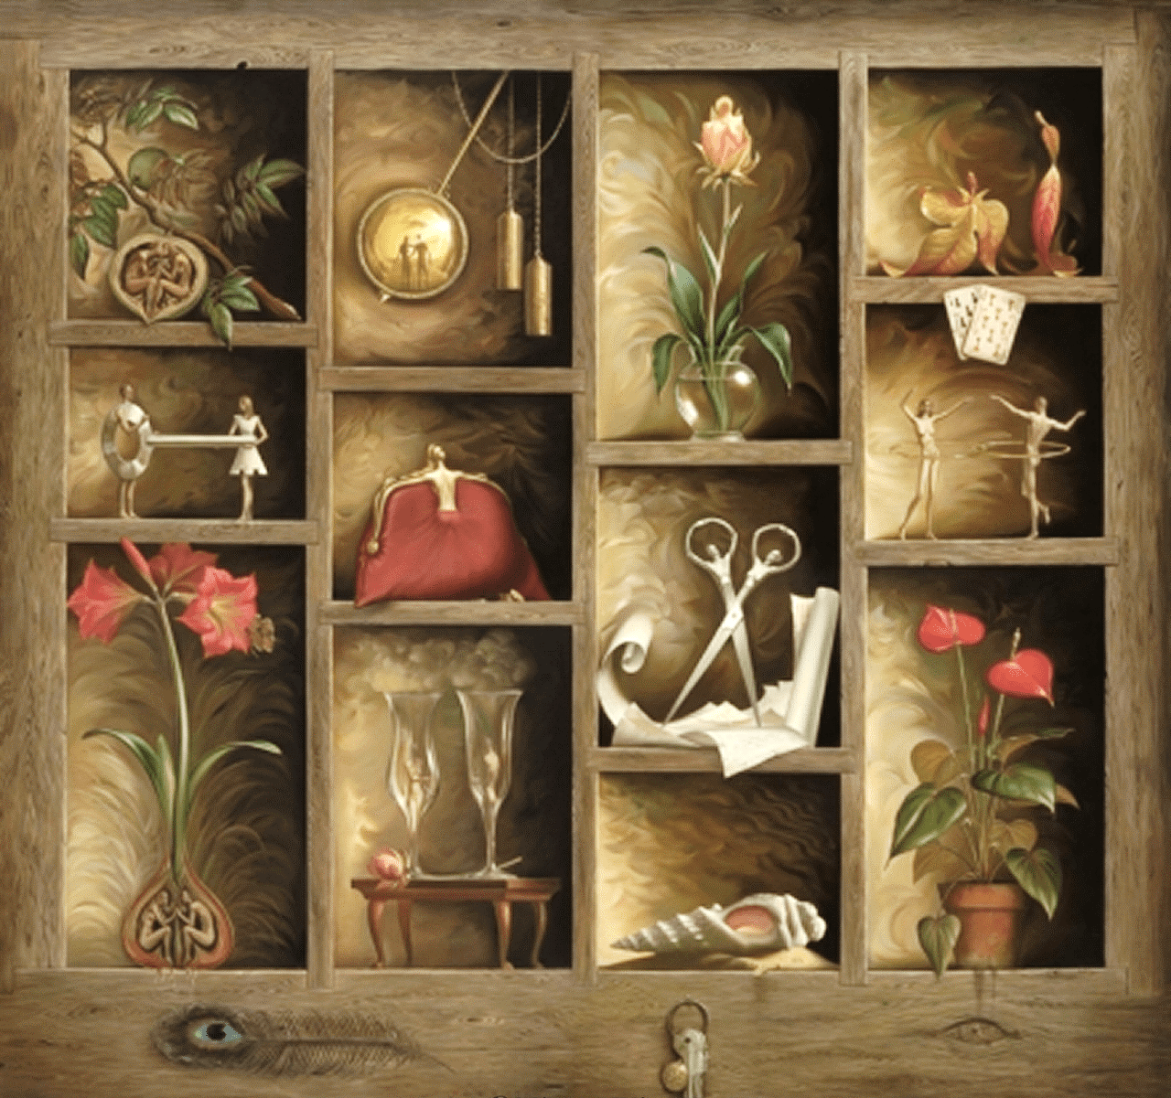
Creativity Techniques
Morphological Analysis
Despite having a wonderful name ( given by its creator, Fritz Zwicky), morphological analysis employs two basic principles of creativity: forced association and decomposition. The issue is divided into its component variables, with potential values for each one determined. By "putting together" various combinations of these values, the association principle is subsequently put into action.
Use it in exploring new and different ideas.
Use it to help unblock you when you are stuck.
Use it to change the way you think.

Slide 32
Creativity Techniques
How to Use Morphological Analysis
Define the problem - Determine the objective of the creative process, define the issue in a concise and clear statement.
Identify the attributes and values - List the aspects of the circumstance that may be altered or modified. Choose two to six variables from the subset to focus on. These will often be important elements of the circumstance. List all potential values for each of the variables from step 3, including any that deviate from the accepted norm (here is an opportunity to get creative).
Combing items - Find a technique to combine things from your previously prepared lists. A matrix may be used, as in the example below, if there are just two lists. Another method involves having six variables in each list and choosing the things to combine by rolling a die for each list. The ways are as varied as you can conceive. Another option is to write them on cards and choose them from six "hats.“ Combine different ideas you have come up with several times, bringing everything together to create a novel answer. If the ideas are not very workable at this moment, do not worry too much about it because they may be developed later or utilized to spark new creative possibilities. Select ideas to use or develop into practical solutions to your problem.

Slide 33
Creativity Techniques
An artist, looking for new ways of creating artwork, identifies two attributes, 'materials' and 'canvas', and then lists the values these can take (e.g. 'ink' is a value of 'materials'). To see if combinations can be formed, (s)he then brings them together in the table below.

Slide 34
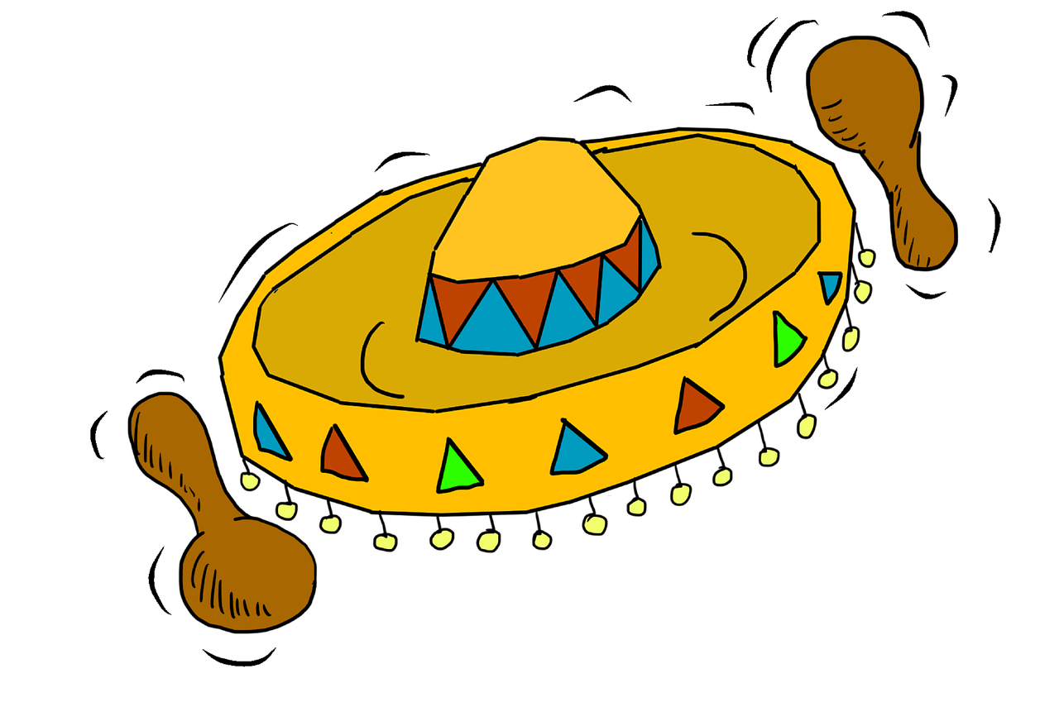
Creativity Techniques
Six Thinking Hats: De Bono
The six hats are not only names for thinking; they also symbolize six different ways of thinking. The hats are therefore applied proactively as opposed to re-actively.
The approach encourages more individuals to contribute fully. According to de Bono, it "separates ego from performance." Since everyone is just using the yellow hat or another hat, they can all contribute to the exploration without hurting each other's egos. The six hats concept promotes performance above ego protection. Regardless of whether they originally favour the opposing viewpoint, anyone can assist in any capacity.
The important thing to remember is that a hat is a way to think rather than a name for thinking. The six thinking hats can be used, in theory, for the following purposes:
Boost Parallel Thinking
Boost full-spectrum thinking
Separate ego from performance

Slide 35
Creativity Techniques
Six Thinking Hats: De Bono
White Hat
This covers facts, figures, information needs and gaps. "I think we need some white hat thinking at this point..." means Let's drop the arguments and proposals, and look at the data base."
Red Hat
This covers intuition, feelings and emotions. The red hat allows the thinker to put forward an intuition without any ned to justify it. "Putting on my red hat, I think this is a terrible proposal.“ The red hat gives full permission to a thinker to put forward his or her feelings on the subject at the moment.
Black Hat
This is the hat of judgment and caution. It is a most valuable hat. It is not in any sense an inferior or negative hat. The black hat is used to point out why a suggestion does not fit the facts, the available experience, the system in use, or the policy that is being followed. The black hat must always be logical.
Yellow Hat
This is the logical positive. Why something will work and why it will offer benefits. It can be used in looking forward to the results of some proposed action, but can also be used to find something of value in what has already happened.
Green Hat
This is the hat of creativity, alternatives, proposals, what is interesting, provocations and changes.
Blue Hat
This is the overview or process control hat. It looks not at the subject itself but at the 'thinking' about the subject. In technical terms, the blue hat is concerned with meta-cognition.
Facts
Feelings
Caution
Benefits
Creativity
Process

Slide 36
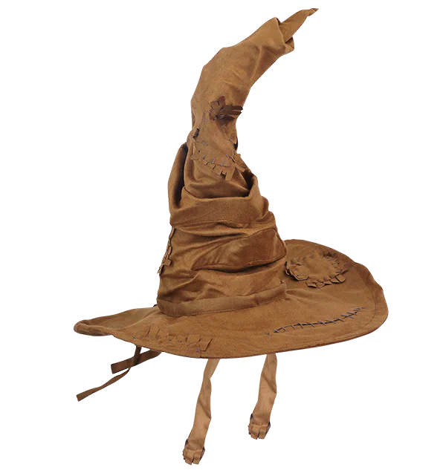
Creativity Techniques
How to Use the Thinking Hats
Use it in teams where you want to use different types of thinking.
Use it where individuals would feel inhibited by taking these roles without prior legitimisation.
Use it to encourage further use of a range of thinking processes.
You can use it to explore ideas when selecting which to take forward.
You can use it to explore how other people will react when you try to implement your idea.
Hat is a useful metaphor: it goes on your head (where you think), and to some extent act as a disguise.
By publicly discussing and agreeing to use the hats, these different thinking styles are not only legitimized but also actively encouraged. Particularly when others start using them, the more timid people will also feel empowered to 'step outside the box'.
Just by discussing the hats, even people who are less inhibited can also get the idea of deliberately thinking in a broader fashion. They can try on the hats to take different views on the situation.
Think about the “Sorting Hat” from Harry Potter.

Slide 37
Creativity Techniques
Examples:
'With my Green hat on, I'd say we should all flap our wings and zoom around the building with our eyes shut.'
'Feeling a bit Red here: I'm getting twitchy about doing this now.'
'With a Black hat, I'd say that we could not afford to do that.'
'Blue calling: The whole contraption is too heavy. It will sink without trace.'
'White hat says I can't decide yet, I need to find out more. Any ideas?'

Slide 38
Creativity Techniques
Five W’s and one H: Six Honest Serving-Men
“I keep six honest serving-men:
(They taught me all I knew)
Their names are What and Where and When
And How and Why and Who.”
From "The Elephant's Child" by Rudyard Kipling
Who?
Why?
What?
Where?
When?
How?

Slide 39
Creativity Techniques
Five W’s and one H: Six Honest Serving-Men
The Five W’s and H are a powerful, creative, and innovative checklist that journalists frequently employ. It is also known as “the Checklist”. The method makes use of the straightforward question-generating prompts that the English language offers. Any amount of formality or pure informality can benefit from the strategy. For instance:
The informal "back of an envelope" method can be used as a quick-aide checklist, a private checklist to remember while in a conversation, brief points to jot down at a meeting, or to spark further inquiries.
The checklist can be helpful as an informal or systematic method of producing lists of questions that you can try to discover answers for during the early phases of issue resolution when you are gathering data.
To come up with thought-provoking queries, The checklist might be used as a source of thought-provoking questions to assist build on current ideas while brainstorming, brainwriting, or using another similar approach.
The checklist could be used to assist create criteria for assessing possibilities.
The checklist is a valuable tool for developing implementation methods for plans.
The "question words," on the other hand, owe their power to the English language's essential place for them, and they can hide some of nature's best qualities that our language does not handle as well. The answers to the checklist's questions are frequently facts rather than statements about events or issues.
For example, the answer to ‘Who does X?’ could be ‘Alice’. To use this answer in a problem-solving context you may have to take to another level
For example ‘OK – if Alice does X, in what way might we make it easier for her.

Slide 40
Creativity Techniques
Random Words
Random Words works in particular by making you go elsewhere for ideas, and hence pushes you out of your current thinking rut. It uses the principle of forced association to make you think in new ways and create very different ideas.
Use it to stimulate open and divergent thinking and seek creative new ideas.
Use it to re-ignite creative thinking when you are running out of ideas.
Use it to get people out of a rut when their thinking is still rather conventional.

Slide 41
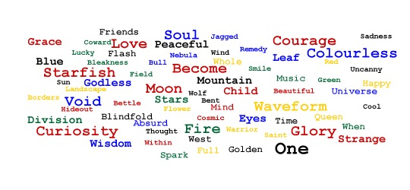
Creativity Techniques
How to Use Random Words
Find a Random Word – You could flick through a dictionary; or you could write words on a bunch of plastic balls, throw them into the air, and then choose the words on the first two balls you catch. Good random words are (a) evocative and (b) nothing to do with the problem being considered. Ambiguity also helps. Nouns are usually best, but verbs and adjectives can also be used effectively.
Find Association – Think about other things the word reminds you of. Follow associations to see where they go. Think openly: associations can be vague and tenuous (this is creativity, not an exam!). When working with a group of people, you can write these down on a flipchart as people call them out. It can be useful (but not necessary) to leave a space after each associate for use in stage 3.
Use association to create ideas - Now, connect any of the associations with your issue to come up with fresh ideas. Again, the connection may be as arbitrary as you like — what matters are the concepts! Write the concepts on a separate page or next to their associations from step 2. You can follow that path to see where it leads if other people's thoughts prompt other ideas from you. Alternative: Combine steps 2 and 3 to generate an association and an instant thought.

Slide 42
Creativity Techniques
Mind Mapping
The mind-map may be produced in any tree-shaped format and is really just a simple hierarchy in its most basic form.
Making notes in cursive type or even as a list of bullet points takes effort and often obfuscates important information.
Mind mapping circumvents these restrictions. Writing branches on curved lines enables them to curve differently in the next branches, creating a corner apex between each branch and thereby separating them (but not too much).
Instead of placing the text on the lines themselves, you might write the words separately and connect them with lines.
Use what works for you when mind mapping, that is the main rule. This entails trying new things, which is obviously acceptable and encouraged, especially in a creative setting.
The brain works by association and thinks in pictures and wholes. Mind-maps aligns with this tendency by showing associative links and being visible as a whole.

Slide 43
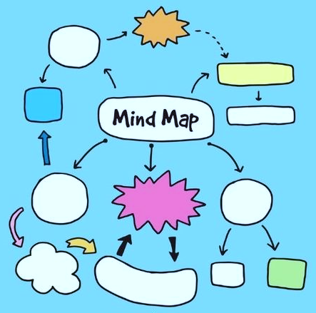
Creativity Techniques
Mind Mapping
The use of colour helps to attract attention, provide mental stimulation and visually separate different areas.
You can also use other forms of emphasis, such as underlining, emboldening, italics, etc.
Pictures are 'worth a thousand words' and can be used to summarise and trigger additional thinking.
The size of the page will constrain what can be mind-mapped. This is often a good thing, as it makes you think more carefully about what to add and keeps it as a visible single chunk.
There are a range of different software programs that are available to help you mind map on the computer. You can also do it with basic presentation software, although this will often take longer and will need more work when you want to reshuffle ideas.
Use it to explore and develop ideas for a specific problem.
Use it to think, doodle and see where it takes you.
Use it to take notes during discussions, lectures and conferences.
Use it to summarize books and papers.

Slide 44
Creativity Techniques
How to Use Mind Mapping
The Main Subject– In the middle of a blank piece of paper, write down the primary issue or subject you want to investigate in a succinct way. You can map more on a larger page, but it's surprising how much information can fit on a standard letter or A4 page. Problems are often expressed as verb-noun phrases. "Buying a car" and "opening a shop" are two examples of verb-noun phrases. If you want, you can also draw a picture to show the problem. Use tone to light it up.
Primary Branches – Find the words that best describe the primary branches of the primary subject at the first level. These are significant because they will direct lower-level thinking. Assuming that they are excessively unambiguous, they will oblige thinking. They will encourage logical thinking, but perhaps not creative thinking, if they are merely logical. These are referred to as Basic Ordering Ideas (BOIs) by Buzan in recognition of their significance. The words for primary (and sub-) branches can be single words or short expressions, however, always know about the effect they will have. Look for keywords that can summarise important points when taking notes. When trying to come up with new ideas, look for words that are both stimulating and ambiguous. Use capital letters or careful printing to ensure that words can be read clearly (cursive scribbles may impede later review).Write the main subject words on branch lines that emanate out from the fundamental subject. Most of the time, this is done in the form of a line with a slight curve that is wider at the main subject and narrows toward the primary branch. It's possible that these come in a variety of hues. Don't worry if you only have one pencil; even black-and-white is superior to other methods. Add pictures and charts any place conceivable to make sense of and investigate.
Sub-branches – Continue adding sub-branches from the primary branches and from other sub-branches to build up the mind-map. You can do as many sub-branches as you like, but by the time you get to around the third level of depth, you will probably find that you are filling up the page very quickly. You can change colour any time that you like. As you get to lower-level branches, you may also want to use smaller writing. When sub-topics seem to want to be in more than one sub-branch, then you can either write it down more than once or connect them with a cross-link (for example a dotted line).

Slide 45
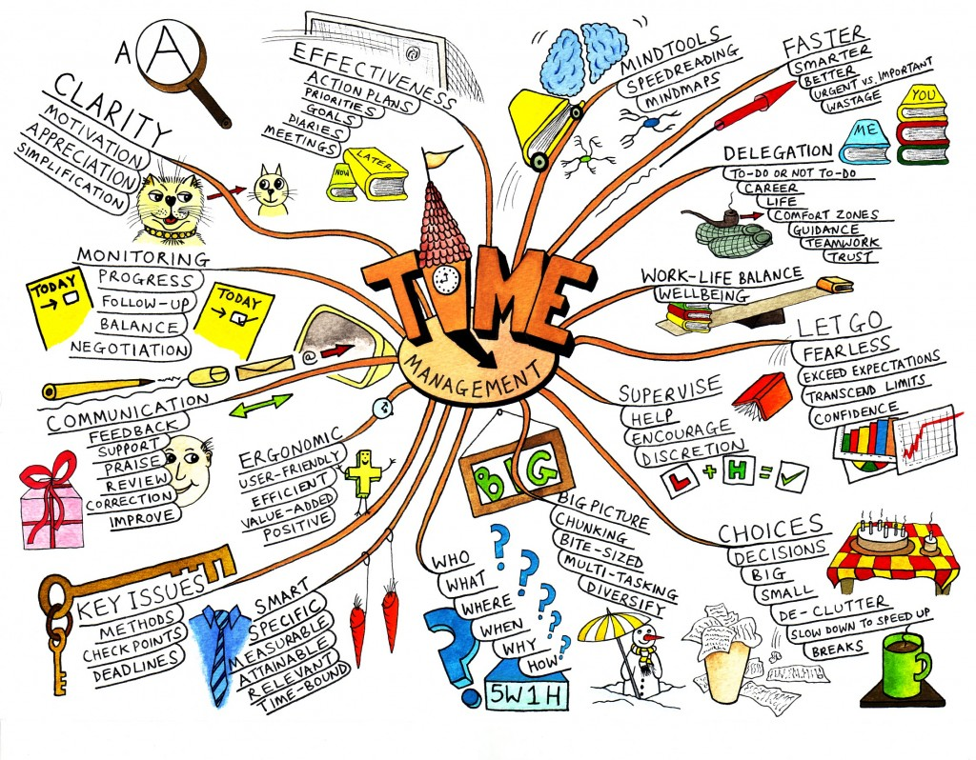
Creativity Techniques
Mind Mapping

Slide 46
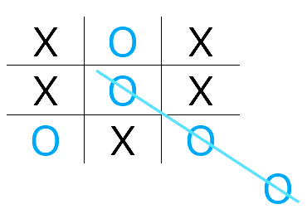
Creativity Techniques
Lateral Thinking
Lateral thinking is about moving sideways when working on a problem to try different perceptions, different concepts and different points of entry. The term covers a variety of methods including provocations to get us out of the usual line of thought. Lateral thinking is cutting across patterns in a self-organising system, and has very much to do with perception.
For example: Granny is sitting knitting and three year old Susan is upsetting Granny by playing with the wool. One parent suggests putting Susan into the playpen. The other parent suggests it might be a better idea to put Granny in the playpen to protect her from Susan. A lateral answer!
The term "Lateral Thinking" can be used in two senses:
Specific: A set of systematic techniques used for changing concepts and perceptions, and generating new ones.
General: Exploring multiple possibilities and approaches instead of pursuing a single approach.

Slide 47
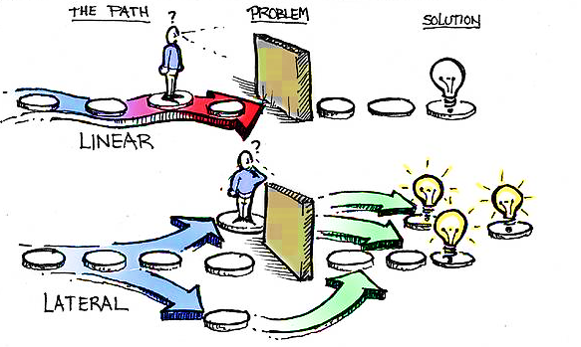
Creativity Techniques
Lateral Thinking

Slide 48
Creativity Techniques
Lateral Thinking – Thinking Outside the Box
Lateral thinking is not an easy concept to teach, but it can be learned through examples.
Edward De Bono in his book explained it as:
“If you were to take a set of toy blocks and build them upwards, each block resting firmly and squarely on the block below it, you would have an illustration of vertical thinking. With lateral thinking the blocks are scattered around. They may be connected to each other loosely or not at all. But the pattern that may eventually emerge can be as useful as the vertical structure”
Lateral thinking is thus very much about standing back, looking at the big picture and understanding concepts. It also requires that you focus in on the parts that have perhaps been overlooked, challenging assumptions and seeking alternatives.

Slide 49
Creativity Techniques
Lateral Thinking
Using a magnifying glass to light a fire when you realize you don’t have matches or a lighter.
Instead of thinking about what you want to achieve, think about what you don’t want to achieve, and find ways to avoid it.
Using a drone to deliver packages instead of a traditional delivery truck.
Using crowdfunding to finance small business and startup projects.

Slide 50
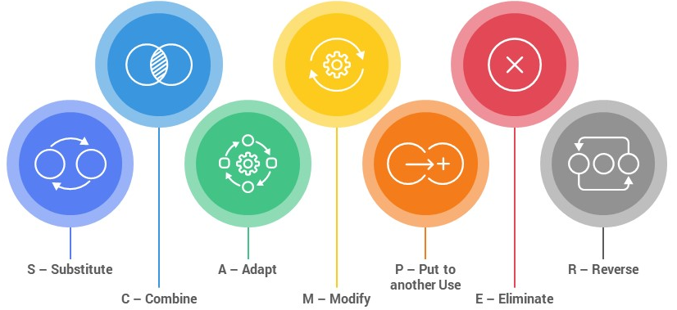
Creativity Techniques
SCAMPER
SCAMPER works by providing a list of active verbs that you associate with your problem and hence create ideas. As they are all verbs, they are about doing, and so get you to think about action.
SCAMPER is an acronym for useful list of words that can be applied as stimuli to make you think differently about the problem area.
Use it to discover more ideas when you are running out.
Use it to stimulate new ways of thinking about the problem, perhaps to kick you out of your current rut.

Slide 51
Creativity Techniques
How to Use SCAMPER
Substitute - What can you substitute? What can be used instead? Who else instead? What other ingredients? Other material? Other process? Other power? Other place? Other approach? Other sounds? Other forces?
Instead of ... I can ...
Combine - What can you combine or bring together somehow? How about a blend, an alloy, an assortment, an ensemble? Combine units? Combine purposes? Combine appeals? Combine ideas?
I can bring together ... and ... to ...
Adapt - What can you adapt for use as a solution? What else is like this? What other idea does this suggest? Does past offer a parallel? What could I copy? Who could I emulate?
I can adapt ... in this way ... to ...
Modify - Can you change the item in some way? Change meaning, colour, motion, sound, smell, form, shape? Other changes?
Also: Magnify: What can you add? More time? Greater frequency? Stronger? Higher? Longer? Thicker? Extra value? Plus ingredient? Duplicate? Multiply? Exaggerate?
And: 'Minify': What can you remove? Smaller? Condensed? Miniature? Lower? Shorter? Lighter? Omit? Streamline? Split up? Understate?
I can change ... in this way ... to ...

Slide 52
Creativity Techniques
How to Use SCAMPER
Put to other uses - How can you put the thing to different or other uses? New ways to use as is? Other uses if it is modified?
I can re-use ... in this way ... by ...
Eliminate - What can you eliminate? Remove something? Eliminate waste? Reduce time? Reduce effort? Cut costs?
I can eliminate ... by ...
Rearrange/ Reverse - What can be rearranged in some way? Interchange components? Other pattern? Other layout? Other sequence? Transpose cause and effect? Change pace? Change schedule?
I can rearrange ... like this ... such that ...

Slide 53
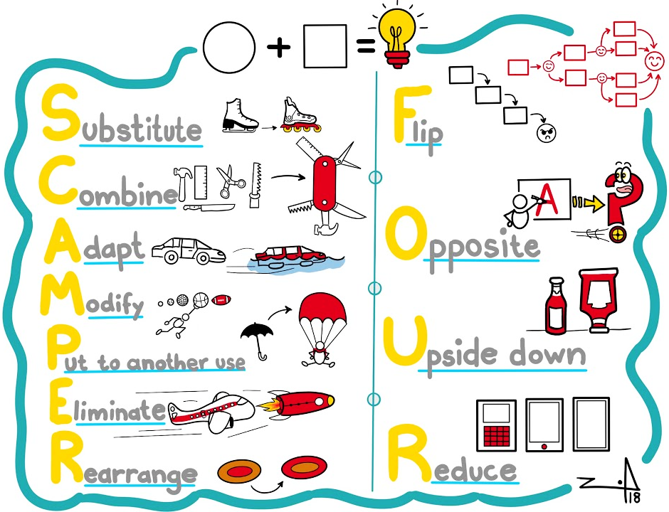
Creativity Techniques
SCAMPER
I want to invent a new type of pen.
Substitute – ink with iron, nib with knife.
Combine -–writing with cutting, holding with opening.
Adapt – pen top as container.
Modify -–body to be flexible.
Put to other uses – use to write on wood.
Eliminate – clip by using velcro.
Rearrange – nib to fold outwards.

Slide 54
Food for Thought
Watch the Video and by applying some of the creativity techniques, come up with ideas that can be created using Fungus.

Slide 55
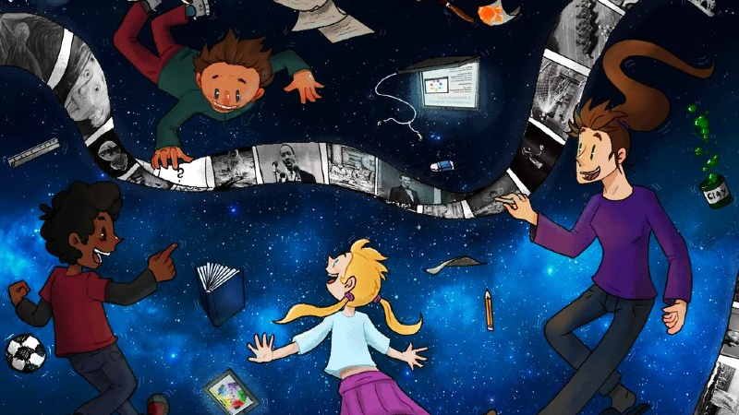
Summary
Creativity is in each of us
Creativity - the freedom to be without limits
A point of view must be kept in mind when posing a problem
Different creative techniques can be used, from random to systematic

Slide 57
BioBeo Project
Innovative Education for the Bioeconomy
www.biobeo.eu

