Slide 1
BioBeo
Creativity Techniques

Slide 2
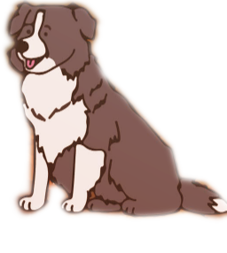
Content
What is Creativity and where does it come from?
Rules of Creativity World
Creativity Techniques
What is Bioeconomy and Why do we need it?
Creativity Exercises for Bioeconomy ideas
Food for Thought

Slide 3
What is Creativity?
Creativity is a tendency of an individual to create new ideas, alternatives, possibilities that may be helpful in solving problems.
According to Albert Einstein “Creativity is intelligence having fun”.
It can be as simple as using leftover pizza toppings to make a sandwich with a smiley face ☺ Or
It can be an artwork created by using plastic.
Creativity can be seen in everything – songs, videos, paintings, games, dance, projects, and much more.

Slide 4
Where does Creativity come from?
Creativity is found in your head and mine.
Scientists state it is a product of brain’s right hemisphere, but they still don’t understand it fully.
Often a result of experimenting, exploring, questioning assumptions, using our imagination, dreams, and experience from world around us.

Slide 5
Where does Creativity come from?
Concepts
Ideas
Imagination
Problem Solving
Thoughts

Slide 6
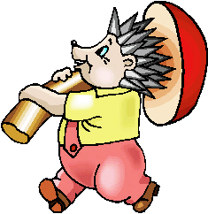
Rules of Creativity World
There are no rules in Creativity World.
The treasures in creativity world are endless and unusual.
The treasures in creativity world are found outside the box.
The gems of creativity world must be carefully recorded so that they can be combined into a large fortune.

Slide 7
7 Innovation Myths
Breakthroughs come from ideas that are unique.
Inventors make scientific breakthroughs.
The world runs into a “right mousetrap”.
All good ideas come from small people.
Great success requires great resources.
A breakthrough needs a special environment.
Breakthrough products always meet an unmet need.

Slide 8
Creativity Techniques
Creative Techniques are tools used to produce plenty of thoughts on best ways to tackle a given issue. By helping "thinking outside the box," they typically aid in expanding the scope of potential solutions and generating truly novel concepts. Creativity techniques can be approached in two ways:
Random Method’s | Systematic Method’s
Any word, Another point of view, rewording… | Metaphors, List of features, Matrix Analysis, Visions of the future, TRIZ (Inventor’s Aid Questions)…
Free from specific information needs. Based on human cognition. There are no evaluation criteria’s. | Functions with more specific information. Less feelings, more system. Involves taking advantage of previous experiences.

Slide 9
Creativity Techniques
There are many techniques for enhancing creativity, each involving different interesting ways to think creatively. Here are some, you can look up others or create one of your own. Don’t restrict yourself to these…
Brainstorming
Brainstorming by Analogies
Brainwriting 6-3-5
Pictures as Idea Triggers
Morphological Chart
Six thinking Hats
Five W’s and one H
Random Words
Mind Mapping
Lateral Thinking
SCAMPER

Slide 10
Creativity Techniques
Brainstorming
Brainstorming consolidates a relaxed, casual way to deal with critical thinking with lateral reasoning. It encourages free association, creativity, and divergent thinking. The main rules are to defer judgment, go for quantity, welcome wild ideas, and build on others’ ideas. It urges individuals to concoct ideas and thoughts that can, from the start, appear to be impractical. This allows people to use each other's ideas to jolting their thinking, and helps to get out of their normal thinking, by making them unstuck to look beyond.
It’s can be used for mostly all kinds of groups.
When brainstorming, everyone is encouraged to participate in a free and open environment. All participants are encouraged to fully contribute, which aids in the development of a wide range of inventive solutions, and unconventional concepts are encouraged and built upon.
The typical time is between thirty and one hour. can be shorter or longer, depending on how hard the problem is and how motivated the group is.

Slide 11
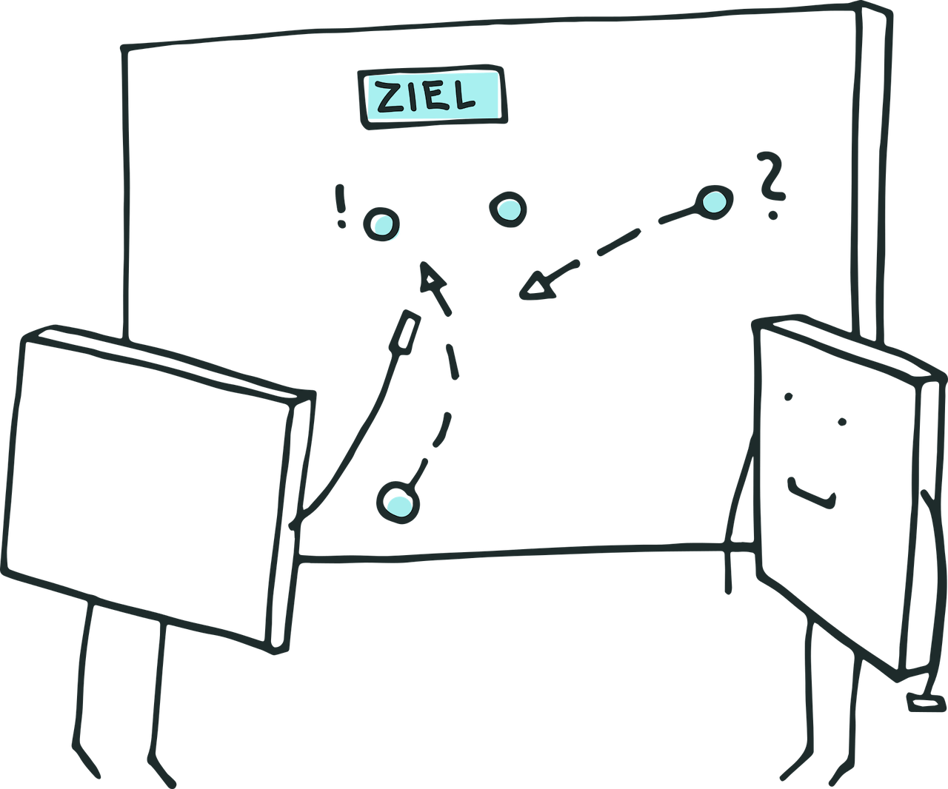
Creativity Techniques
Brainstorming by Analogies
When you state that something is similar to something else (in some ways but not in others), you are using an analogy. For instance, a jumbo jet and an albatross are similar in that they both fly, have wings, can go great distances without stopping, and can sense where they are going; nevertheless, they differ in that they use various propulsion systems, are constructed from various materials, etc.
Many methods for fostering creativity include analogies as a major component. An informal way of using an analogy is to say, "This problem makes me think of X (analogy), which suggests to me that maybe we could try Y (idea derived from analogy X)."

Slide 12
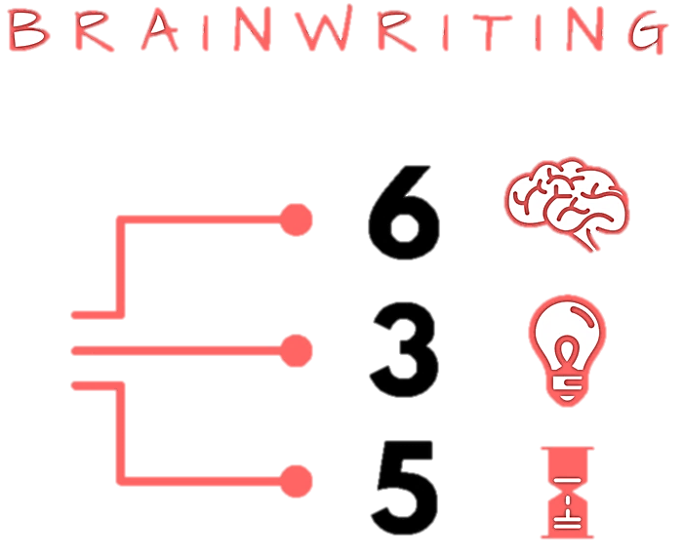
Creativity Techniques
Brainwriting 6-3-5
The process of six people writing three ideas in five minutes.
In particular, for groups of people who are somewhat reluctant and can't provide a lot of ideas at an open group session like Brainstorming, Brainwriting is very helpful.
It is also helpful when each one of us has a problem which he or she wishes to solve.
It's very well suited to large groups, and it doesn't really impose any limits on group size.

Slide 13
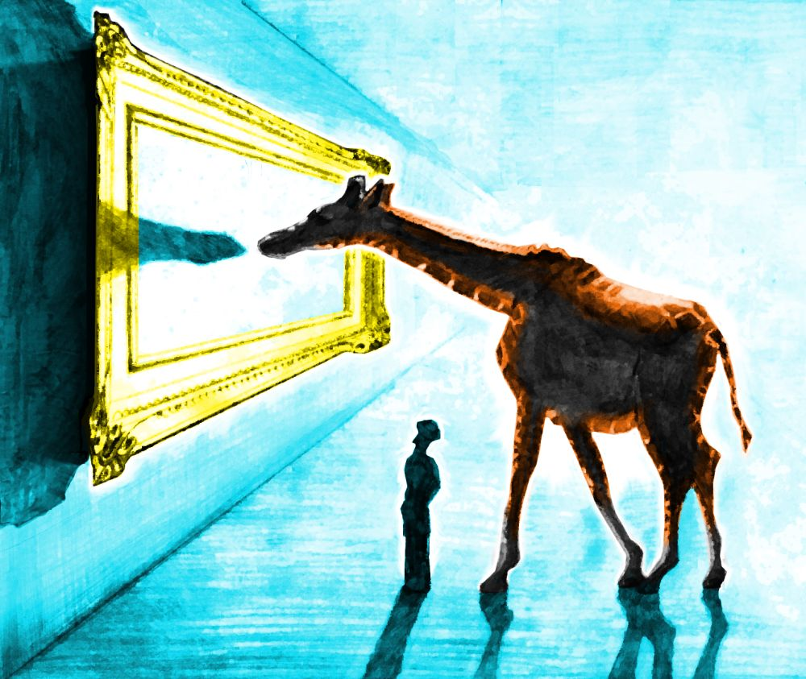
Creativity Techniques
Pictures as Idea Triggers
Pictures can be a powerful tool for triggering ideas and stimulating creativity. When we see an image, our brain immediately begins to process it and make associations with other concepts, memories, and emotions. These associations can spark new ideas and insights that we might not have considered otherwise.
Pictures can also help us to break out of our usual patterns of thinking and see things from a fresh perspective. For example, if you're stuck on a problem or idea, looking at a picture of a related concept or a completely unrelated subject could help you make connections and generate new ideas.
Additionally, pictures can evoke strong emotions and create a mood or atmosphere that can inspire creativity. A beautiful landscape, an interesting character, or a striking abstract image can all elicit different feelings and ideas.
Overall, pictures can serve as a powerful source of inspiration and idea triggers, allowing us to tap into our imagination and explore new possibilities.

Slide 14
Creativity Techniques

Slide 15
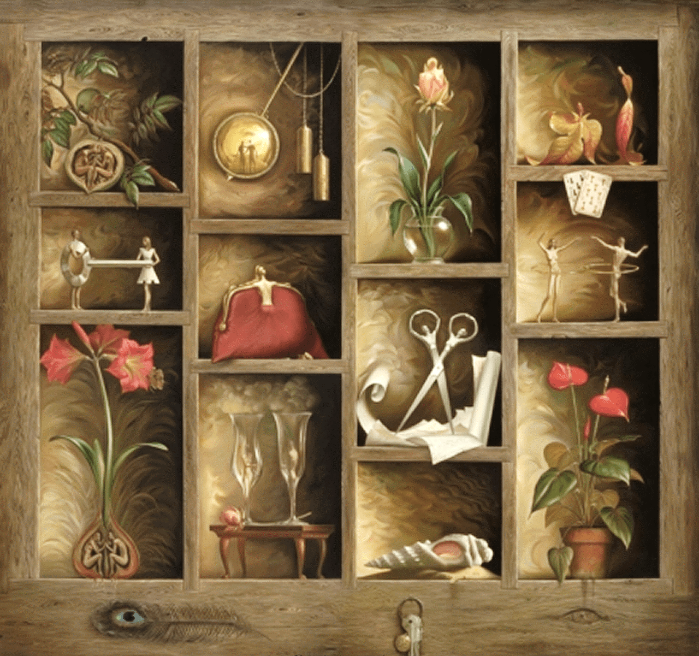
Creativity Techniques
Morphological Analysis
Despite having a wonderful name (given by its creator, Fritz Zwicky), morphological analysis employs two basic principles of creativity: forced association and decomposition. The issue is divided into its component variables, with potential values for each one determined. By "putting together" various combinations of these values, the association principle is subsequently put into action.
Use it in exploring new and different ideas.
Use it to help unblock you when you are stuck.
Use it to change the way you think.

Slide 16
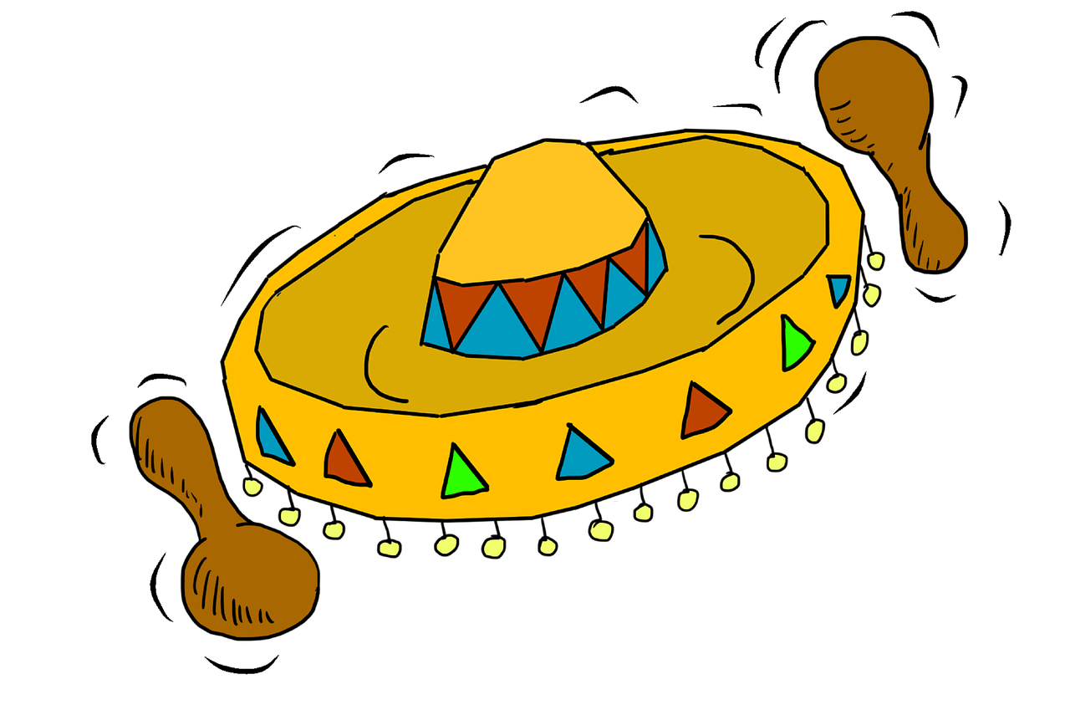
Creativity Techniques
Six Thinking Hats: De Bono
The six hats are not only names for thinking; they also symbolize six different ways of thinking. The hats are therefore applied proactively as opposed to re-actively.
The approach encourages more individuals to contribute fully. According to de Bono, it "separates ego from performance." Since everyone is just using the yellow hat or another hat, they can all contribute to the exploration without hurting each other's egos. The six hats concept promotes performance above ego protection. Regardless of whether they originally favour the opposing viewpoint, anyone can assist in any capacity.
The important thing to remember is that a hat is a way to think rather than a name for thinking. The six thinking hats can be used, in theory, for the following purposes:
Boost Parallel Thinking
Boost full-spectrum thinking
Separate ego from performance

Slide 17
Creativity Techniques
Six Thinking Hats: De Bono
White Hat
This covers facts, figures, information needs and gaps. "I think we need some white hat thinking at this point..." means Let's drop the arguments and proposals, and look at the data base."
Red Hat
This covers intuition, feelings and emotions. The red hat allows the thinker to put forward an intuition without any ned to justify it. "Putting on my red hat, I think this is a terrible proposal.“ The red hat gives full permission to a thinker to put forward his or her feelings on the subject at the moment.
Black Hat
This is the hat of judgment and caution. It is a most valuable hat. It is not in any sense an inferior or negative hat. The black hat is used to point out why a suggestion does not fit the facts, the available experience, the system in use, or the policy that is being followed. The black hat must always be logical.
Yellow Hat
This is the logical positive. Why something will work and why it will offer benefits. It can be used in looking forward to the results of some proposed action, but can also be used to find something of value in what has already happened.
Green Hat
This is the hat of creativity, alternatives, proposals, what is interesting, provocations and changes.
Blue Hat
This is the overview or process control hat. It looks not at the subject itself but at the 'thinking' about the subject. In technical terms, the blue hat is concerned with meta-cognition.
Facts
Feelings
Caution
Benefits
Creativity
Process

Slide 18
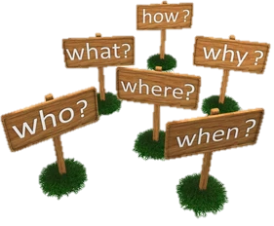
Creativity Techniques
Five W’s and one H: Six Honest Serving-Men
“I keep six honest serving-men:
(They taught me all I knew)
Their names are What and Where and When
And How and Why and Who.”
From "The Elephant's Child" by Rudyard Kipling
Who?
Why?
What?
Where?
When?
How?

Slide 19
Creativity Techniques
Five W’s and one H: Six Honest Serving-Men
The Five W’s and H are a powerful, creative, and innovative checklist that journalists frequently employ. It is also known as “the Checklist”. The method makes use of the straightforward question-generating prompts that the English language offers. Any amount of formality or pure informality can benefit from the strategy. For instance:
The informal "back of an envelope" method can be used as a quick-aide checklist, a private checklist to remember while in a conversation, brief points to jot down at a meeting, or to spark further inquiries.
The checklist can be helpful as an informal or systematic method of producing lists of questions that you can try to discover answers for during the early phases of issue resolution when you are gathering data.
To come up with thought-provoking queries, The checklist might be used as a source of thought-provoking questions to assist build on current ideas while brainstorming, brainwriting, or using another similar approach.
The checklist could be used to assist create criteria for assessing possibilities.
The checklist is a valuable tool for developing implementation methods for plans.
The "question words," on the other hand, owe their power to the English language's essential place for them, and they can hide some of nature's best qualities that our language does not handle as well. The answers to the checklist's questions are frequently facts rather than statements about events or issues.
For example, the answer to ‘Who does X?’ could be ‘Alice’. To use this answer in a problem-solving context you may have to take to another level
For example ‘OK – if Alice does X, in what way might we make it easier for her.

Slide 20
Creativity Techniques
Random Words
Random Words works in particular by making you go elsewhere for ideas, and hence pushes you out of your current thinking rut. It uses the principle of forced association to make you think in new ways and create very different ideas.
Use it to stimulate open and divergent thinking and seek creative new ideas.
Use it to re-ignite creative thinking when you are running out of ideas.
Use it to get people out of a rut when their thinking is still rather conventional.

Slide 21
Creativity Techniques
Mind Mapping
The mind-map may be produced in any tree-shaped format and is really just a simple hierarchy in its most basic form.
Making notes in cursive type or even as a list of bullet points takes effort and often obfuscates important information.
Mind mapping circumvents these restrictions. Writing branches on curved lines enables them to curve differently in the next branches, creating a corner apex between each branch and thereby separating them (but not too much).
Instead of placing the text on the lines themselves, you might write the words separately and connect them with lines.
Use what works for you when mind mapping, that is the main rule. This entails trying new things, which is obviously acceptable and encouraged, especially in a creative setting.
The brain works by association and thinks in pictures and wholes. Mind-maps aligns with this tendency by showing associative links and being visible as a whole.

Slide 22
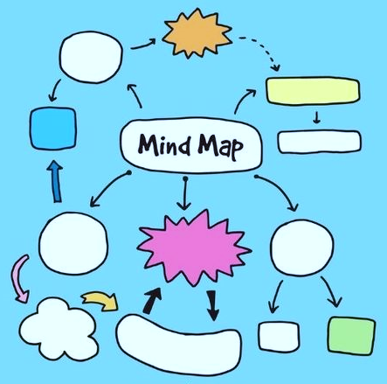
Creativity Techniques
Mind Mapping
The use of colour helps to attract attention, provide mental stimulation and visually separate different areas.
You can also use other forms of emphasis, such as underlining, emboldening, italics, etc.
Pictures are 'worth a thousand words' and can be used to summarize and trigger additional thinking.
The size of the page will constrain what can be mind-mapped. This is often a good thing, as it makes you think more carefully about what to add and keeps it as a visible single chunk.
There are a range of different software programs that are available to help you mind map on the computer. you can also do it with basic presentation software, although this will often take longer and will need more work when you want to reshuffle ideas.
Use it to explore and develop ideas for a specific problem.
Use it to think, doodle and see where it takes you.
Use it to take notes during discussions, lectures and conferences.
Use it to summarize books and papers.

Slide 23
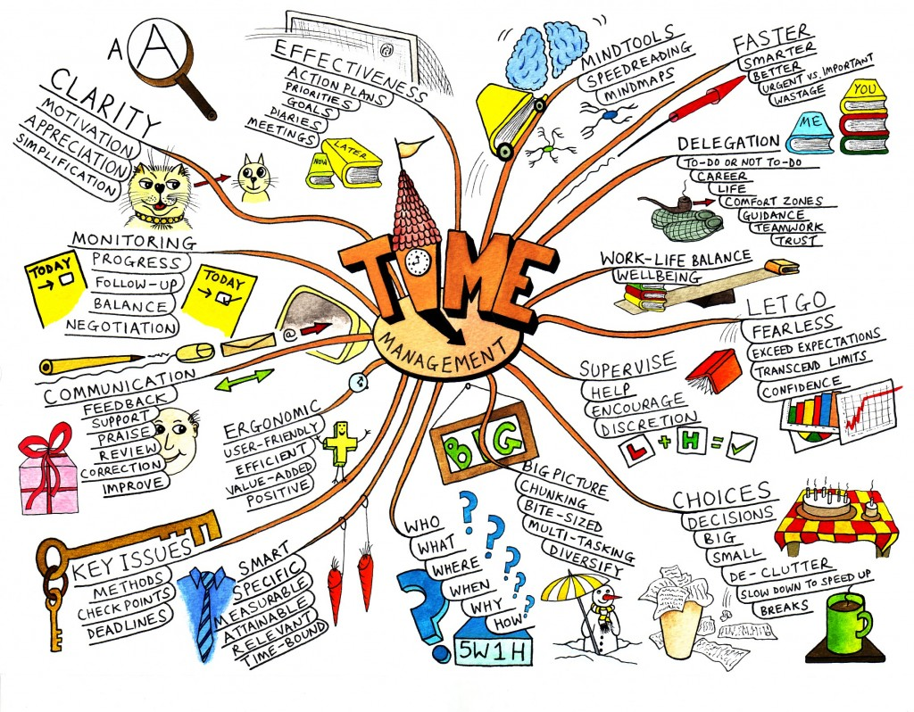
Creativity Techniques
Mind Mapping

Slide 24
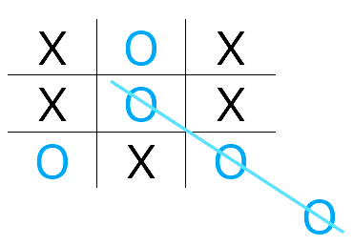
Creativity Techniques
Lateral Thinking
Lateral thinking is about moving sideways when working on a problem to try different perceptions, different concepts and different points of entry. The term covers a variety of methods including provocations to get us out of the usual line of thought. Lateral thinking is cutting across patterns in a self-organising system, and has very much to do with perception.
For example: Granny is sitting knitting and three year old Susan is upsetting Granny by playing with the wool. One parent suggests putting Susan into the playpen. The other parent suggests it might be a better idea to put Granny in the playpen to protect her from Susan. A lateral answer!
The term "Lateral Thinking" can be used in two senses:
Specific: A set of systematic techniques used for changing concepts and perceptions, and generating new ones.
General: Exploring multiple possibilities and approaches instead of pursuing a single approach.

Slide 25
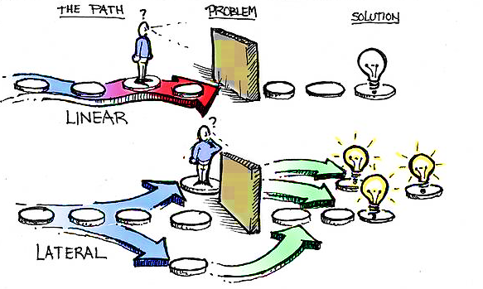
Creativity Techniques
Lateral Thinking

Slide 26
Creativity Techniques
Lateral Thinking – Thinking Outside the Box
Lateral thinking is not an easy concept to teach, but it can be learned through examples.
Edward De Bono in his book explained it as:
“If you were to take a set of toy blocks and build them upwards, each block resting firmly and squarely on the block below it, you would have an illustration of vertical thinking. With lateral thinking the blocks are scattered around. They may be connected to each other loosely or not at all. But the pattern that may eventually emerge can be as useful as the vertical structure”
Lateral thinking is thus very much about standing back, looking at the big picture and understanding concepts. It also requires that you focus in on the parts that have perhaps been overlooked, challenging assumptions and seeking alternatives.

Slide 27
Creativity Techniques
Lateral Thinking
Using a magnifying glass to light a fire when you realize you don’t have matches or a lighter.
Instead of thinking about what you want to achieve, think about what you don’t want to achieve, and find ways to avoid it.
Using a drone to deliver packages instead of a traditional delivery truck.
Using crowdfunding to finance small business and startup projects.

Slide 28
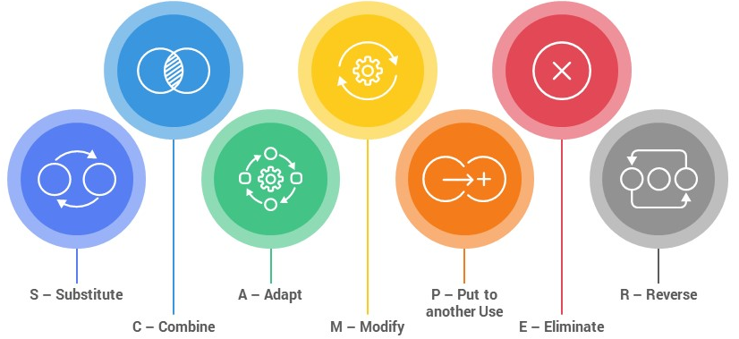
Creativity Techniques
SCAMPER
SCAMPER works by providing a list of active verbs that you associate with your problem and hence create ideas. As they are all verbs, they are about doing, and so get you to think about action.
SCAMPER is an acronym for useful list of words that can be applied as stimuli to make you think differently about the problem area.
Use it to discover more ideas when you are running out.
Use it to stimulate new ways of thinking about the problem, perhaps to kick you out of your current rut.

Slide 29
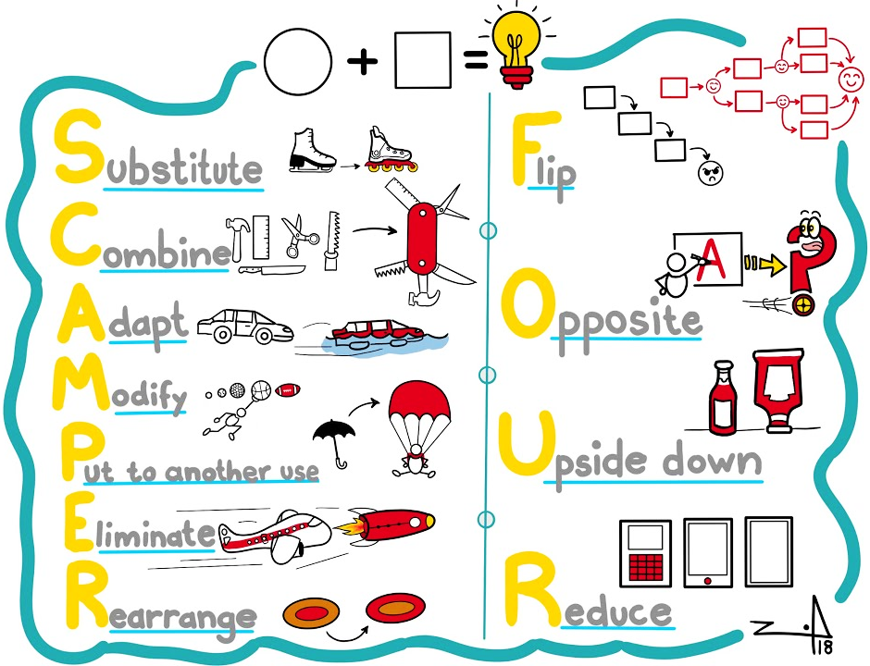
Creativity Techniques
SCAMPER
I want to invent a new type of pen.
Substitute - ink with iron, nib with knife
Combine - writing with cutting, holding with opening
Adapt - pen top as container
Modify - body to be flexible
Put to other uses - use to write on wood
Eliminate - clip by using velcro
Rearrange - nib to fold outwards

Slide 30
Why do we need Bioeconomy?
The World is facing many challenges today, such as climate change, food security, natural resource depletion, and environmental degradation.
Bioeconomy is based on the use of renewable biological resources, such as plants, animals, and microorganisms, to produce food, materials, and energy in a sustainable and circular way. By doing so, bioeconomy can reduce our dependence on fossil fuels, lower greenhouse gas emissions, protect biodiversity, and create new value chains and jobs.
Some examples of bioeconomy are:
Food systems that produce nutritious and safe food while minimizing waste and environmental impact.
Bio-based products and processes that use biomass or biotechnology to create new materials, chemicals, and bioplastics.
Bioenergy that converts biomass or biowaste into fuels, electricity, or heat.
Blue bioeconomy that exploits the potential of marine and aquatic resources for food, feed, bioproducts, and bioenergy.

Slide 31
Why do we need Bioeconomy?
Bioeconomy is a key model for sustainable development that can benefit both people and the planet.
Bioeconomy can also contribute to the achievement of the United Nations Sustainable Development Goals (SDGs), such as ending hunger, ensuring health and well-being, promoting clean energy, and fostering innovation.
Therefore, it comes to each one of us (you and me) to come up with bioeconomy ideas that can be used in schools, in neighbourhood, in communities at national level and International level.
Here are some exercises to use creativity for Bioeconomy.

Slide 32
Bioeconomy examples
Bioeconomy Brainstorm:
This is an exercise that helps generate new ideas for bio-based products or services that can solve a problem or meet a need.
Start by choosing a topic or a challenge that is interesting, such as energy, waste, health, etc.
Then, get students to use the SCAMPER technique to think of different ways to improve or innovate existing solutions using biological resources, processes or principles.
SCAMPER stands for Substitute, Combine, Adapt, Modify, Put to another use, Eliminate and Reverse.
For example:
substitute plastic bottles with biodegradable ones made from algae,
combine solar panels with plants to produce electricity and oxygen,
adapt mushrooms to grow into furniture or packaging,
modify bacteria to produce insulin or antibiotics,
put coffee grounds to another use as fertilizer or fuel,
eliminate harmful chemicals from cleaning products with enzymes or microorganisms,
reverse the process of making paper from wood to make wood from paper.

Slide 33
Bioeconomy examples
Bioeconomy Bingo:
This is a game that helps discover the bio-based products that are around us in daily life.
To play bioeconomy bingo, you need a bingo card with different bio-based products or processes on it, such as bioplastics, biofuels, biorefineries, etc. For example, a carrot is a bio-based food, a cotton cloth napkin is a bio-based clothing, and a solar panel is a bio-based energy.
Printed or hand crafted bingo cards should be distributed based on the bioeconomy topic. A sample bingo is available on next slide.
You also need a caller who will randomly select and announce a bio-based product or process from a list. The players have to mark the corresponding square on their bingo card if they have it.
The first player who gets five squares in a row, column or diagonal wins the game.
Notes:
This is a game that helps you discover the bio-based products that are around you in your daily life. You can print out a bingo card with different categories of products, such as food, clothing, cosmetics, packaging, etc. Then, you can ask to look for items that are made from biological resources, such as plants, animals, microorganisms, or natural resources. For example, a banana is a bio-based food, a cotton shirt is a bio-based clothing, and a soap bar is a bio-based cosmetic. You can ask to mark the items on the bingo card and ask to try to complete a row, a column or a diagonal. You can also teach more about the benefits of using bio-based products instead of fossil-based ones during this exercise.

Slide 34
Bioeconomy examples

Slide 35
Bioeconomy examples
Bioeconomy Art:
This is an exercise that helps to express creativity and appreciation for the bioeconomy through art.
Different materials and techniques can be used to create artwork inspired by the bioeconomy.
For example, students can paint with natural pigments extracted from plants or fruits, sculpt with clay or paper mache made from recycled paper or cardboard, or draw with pencils or crayons made from wood or wax.

Slide 36
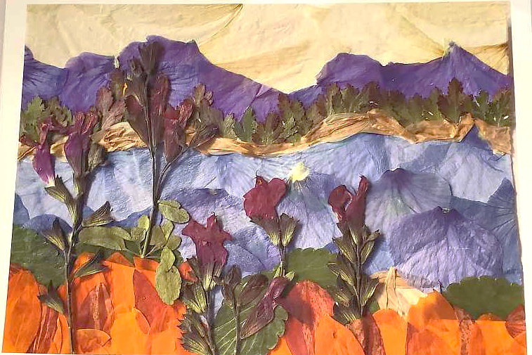
Bioeconomy examples
Bioeconomy Collage: This is an exercise that helps express creativity and vision for the bioeconomy through art. Students can use different materials and techniques to create own collage inspired by the bioeconomy. For example, they can cut out images or words related to the bioeconomy from magazines or newspapers, glue them on a cardboard or paper, and add some decorations or drawings. They can also use natural materials, such as leaves, flowers, seeds, or shells, to make collage more colourful and organic.

Slide 37
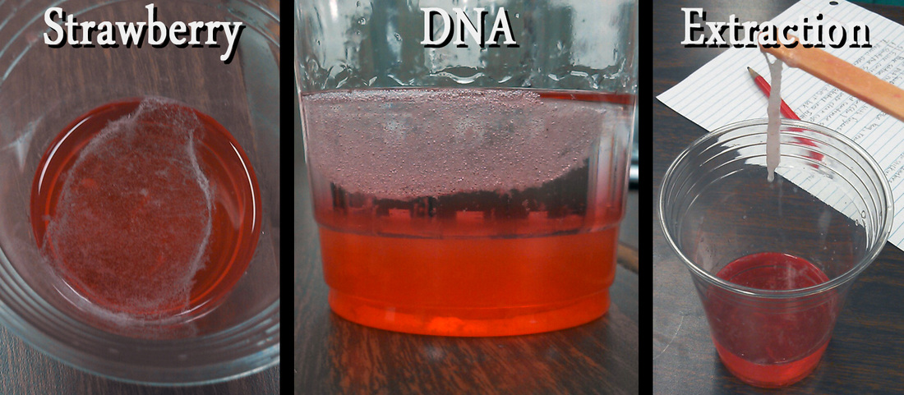
Bioeconomy examples
Bioeconomy Experiment:
This is an exercise that helps explore the bioeconomy through hands-on activities and experiments.
1. Extracting DNA from Strawberries
Materials:
A resealable plastic bag
2 strawberries (fresh or frozen, but remove the green leaves)
2 teaspoon dish detergent
1 teaspoon salt
½ cup water
2 plastic cups
1 coffee filter
½ cup cold rubbing alcohol
1 coffee stirrer

Slide 38
Bioeconomy examples
Steps:
Mix the dish detergent, salt, and water in one of the plastic cups. This is your extraction liquid, which will help break down the cell membranes and release the DNA from the strawberries.
Place the strawberries in the plastic bag and seal it. Smash the strawberries with your fingers for about 2 minutes until they are well mashed.
Add the extraction liquid to the bag and reseal it. Gently massage and mix the bag for another minute.
Place the coffee filter over the opening of the second plastic cup and secure it with a rubber band or tape. Pour the contents of the bag onto the filter and let the liquid drip through into the cup. This is your filtered strawberry extract.
Pour an equal amount of cold rubbing alcohol into the cup with the strawberry extract. Do not stir or shake the cup.
Observe the white, stringy material that forms in the upper layer of liquid. This is the strawberry DNA! You can use a coffee stirrer to pick it up and examine it.

Slide 39
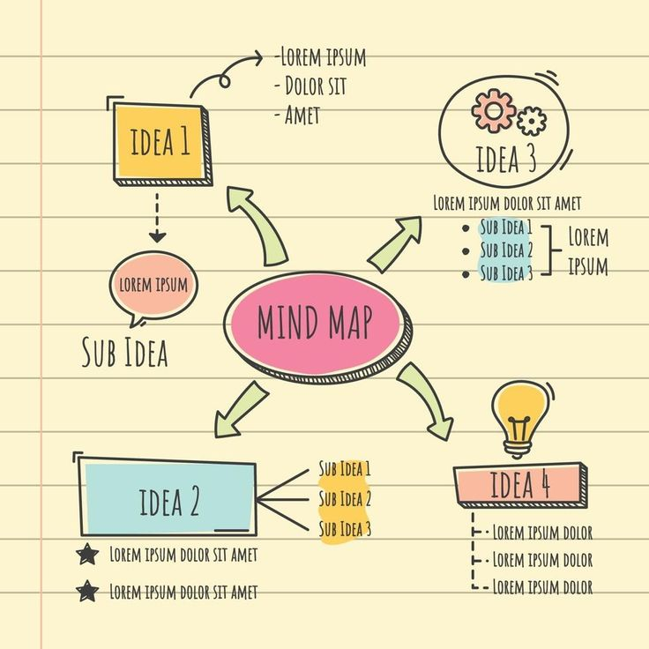
Bioeconomy examples
Growing Mushroom’s from Coffee Ground
Materials required:
Straw (cut into four inch pieces)
Oyster mushroom spawn (you can buy online or from a local mushroom producer)
Freshly used coffee grounds
Isopropyl alcohol (at least 70 percent)
Cooking pot
Clear plastic garbage bags or food storage bags
Twist tie or elastic bands
Kitchen scale
Thermometer
Strainer
Salad spinner
Gloves
Spray bottle
Cutter/ knife

Slide 40
Bioeconomy examples
Steps:
Wipe down all of your materials with rubbing alcohol to disinfect them and prevent the spread of unwanted bacteria.
Pasteurize your straw by immersing it in boiled water at 77 degrees Celsius for an hour and fifteen minutes. You can use your thermometer to measure the temperature of the water.
Drain your straw using a strainer and use a salad spinner to remove excess water.
Mix your coffee grounds and straw in a container. The ratio should be about 70 percent coffee grounds, 20 percent straw, and 10 percent mushroom spawn. You can use your kitchen scale to weigh each item. Break apart any clumps of coffee with your hands or sanitised utensils.
Transfer the mixture to a plastic bag and seal it with a twist tie or an elastic band. Make sure there is some air inside the bag.
Punch around 25 holes in the bag with a cutter/knife to allow air circulation and prevent anaerobic conditions.
Place the bag in a warm, dark place for 2–3 weeks. The ideal temperature is between 20 and 24 degrees Celsius for oyster mushrooms. During this time, the mycelium will colonize the coffee grounds. Mycelium is a network of white, strand-like structures that form the body of the fungus.
When you see white patches of mycelium covering most of the surface of the bag, move it to a bright place with indirect sunlight and high humidity. You can use a spray bottle to mist the bag daily to keep it moist.
After a few days, you will see small mushroom pins forming on the surface of the bag. These are the beginnings of your mushrooms. They will grow rapidly and double in size every day.
Harvest your mushrooms when they are fully grown and before they release their spores. You can tell by looking at the edges of their caps. If they are curled inward, they are not ready yet. If they are flat or curled outward, they are ready to harvest. To harvest, twist and pull gently at the base of the mushroom cluster.
Enjoy your fresh oyster mushrooms! You can store them in a paper bag in the refrigerator for up to a week or dry them for longer storage.

Slide 41
Food for Thought
Watch the Video and by applying some of the creativity techniques come up with ideas that can be created using Fungus.

Slide 42
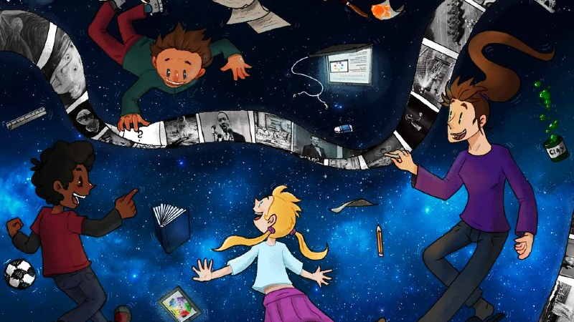
Summary
Creativity is in each of us.
Creativity - the freedom to be without limits.
A point of view must be kept in mind when posing a problem.
Different creative techniques can be used, from random to systematic.

Slide 44
BioBeo Project
Innovative Education for the Bioeconomy

