Slide 1
BioBeo
Creativity Techniques for Bioeconomy

Slide 2
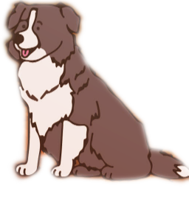
Content
What is Creativity and where does it come from?
Rules of Creativity World
Creativity Techniques
Food for Thought

Slide 3

What is Creativity?
Creativity is a tendency of an individual to create new ideas, alternatives, possibilities that may be helpful in solving problems.
According to Albert Einstein “Creativity is intelligence having fun”.
It can be as simple as using leftover pizza toppings to make a sandwich with a smiley face ☺ Or
It can be an artwork created by using plastic.
Creativity can be seen in everything – songs, videos, paintings, games, dance, projects, and much more.

Slide 4

Where does Creativity come from?
Creativity is found in your head and mine.
Scientists state it is a product of the brain’s right hemisphere, but they still don’t understand it fully.
Often a result of experimenting, exploring, questioning assumptions, using our imagination, dreams, and experience from the world around us.

Slide 5

Where does Creativity come from?
Concepts
Ideas
Imagination
Problem Solving
Thoughts

Slide 6

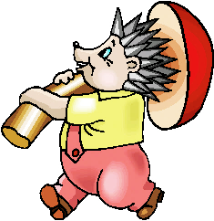
Rules of Creativity World
There are no rules in Creativity World.
The treasures in creativity world are endless and unusual.
The treasures in creativity world are found outside the box.
The gems of creativity world must be carefully recorded so that they can be combined into a large fortune.

Slide 7

Creativity Techniques
Creative Techniques are tools used to produce plenty of thoughts, on the best ways of tackling a given issue. By helping "thinking outside the box," they typically aid in expanding the scope of potential solutions and generating truly novel concepts. Creativity techniques can be approached in two ways:
Random Methods | Systematic Methods
Any word, Another point of view, rewording… | Metaphors, List of features, Matrix Analysis, Visions of the future, TRIZ (Inventor’s Aid Questions)…
Free from specific information needs. Based on human cognition. There are no evaluation criterias. | Functions with more specific information. Less feelings, more systematic. Involves taking advantage of previous experiences.

Slide 8
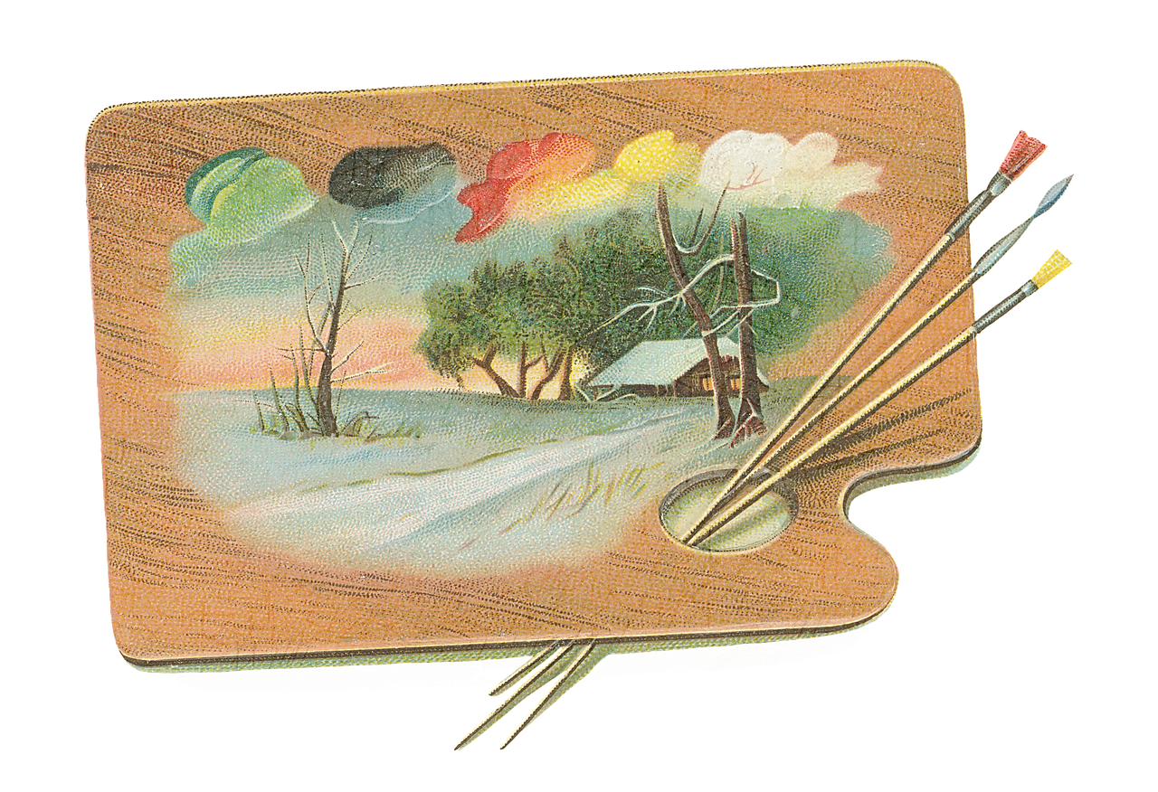
Creativity Techniques
There are many techniques for enhancing creativity, each involving different interesting ways to think creatively. Here are some, you can look up others or create one of your own. Don’t restrict yourself to these...
Brainstorming
Pictures as Idea Triggers
Morphological Analysis
Six Thinking Hats
Five Ws and one H
Random Words
Mind Mapping
SCAMPER

Slide 9

Creativity Techniques
Brainstorming
Brainstorming consolidates a relaxed, casual way to deal with critical thinking with lateral reasoning. It encourages free association, creativity, and divergent thinking. The main rules are to defer judgment, go for quantity, welcome wild ideas, and build on others’ ideas. It urges individuals to concoct ideas and thoughts that can, from the start, appear to be impractical. This allows people to use each other's ideas to jolt their thinking, and helps to get out of their normal thinking, by making them unstuck to look beyond.
For example, a group of people share their thoughts and suggestions on how to use biological resources to create new products or services. For example, they might come up with ideas such as:
    Biodegradable packaging made from algae or fungi.
    Biofuel from waste cooking oil or agricultural residues.
    Bioplastics from corn starch or sugarcane.
    Biofertilizer from seaweed or animal manure.
    Biomimetic materials inspired by nature, such as spider silk or lotus leaf.

Slide 10
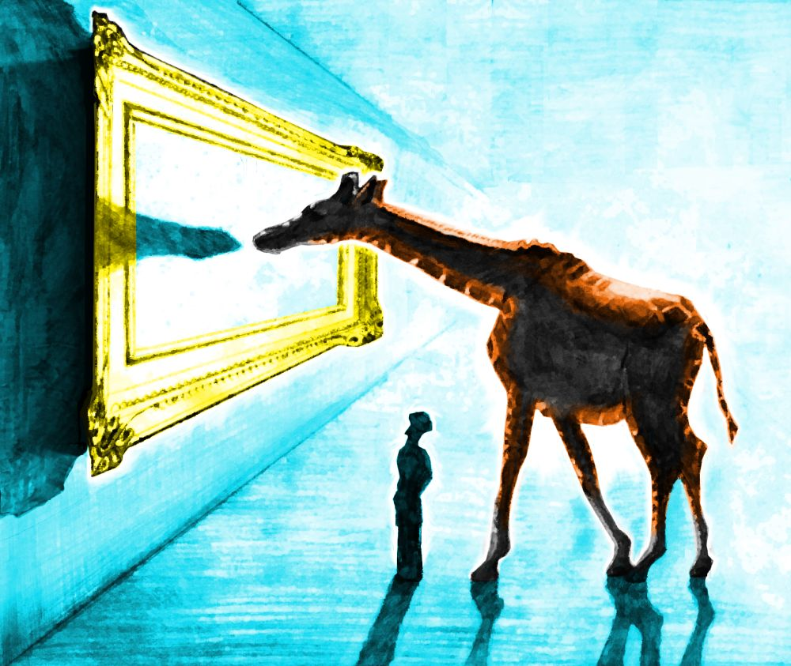
Creativity Techniques
Pictures as Idea Triggers
Pictures can be powerful tools for triggering ideas and stimulating creativity. When we see an image, our brain immediately begins to process it and make associations with other concepts, memories, and emotions. These associations can spark new ideas and insights that we might not have considered otherwise.
Pictures can also help us to break out of our usual patterns of thinking and see things from a fresh perspective. For example, if you're stuck on a problem or idea, looking at a picture of a related concept or a completely unrelated subject could help you make connections and generate new ideas.
Additionally, pictures can evoke strong emotions and create a mood or atmosphere that can inspire creativity. A beautiful landscape, an interesting character, or a striking abstract image can all elicit different feelings and ideas.
Overall, pictures can serve as a powerful source of inspiration and idea triggers, allowing us to tap into our imagination and explore new possibilities.

Slide 11
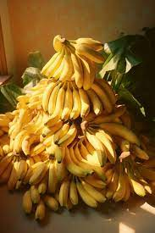




Creativity Techniques
Pictures as Idea Triggers
A bio-based paint made from beetroot juice, inspired by a picture of a red wall.
A bio-based fertilizer made from worm castings, inspired by a picture of a garden.
A piece of bio-based leather made from mushroom mycelium, inspired by a picture of a leather jacket.
A piece of bio-based paper made from banana peels, inspired by a picture of a banana bunch.
A bar of bio-based soap made from coconut oil, inspired by a picture of a coconut tree.

Slide 12

Creativity Techniques
Morphological Analysis
Despite having a wonderful name (given by its creator, Fritz Zwicky), morphological analysis employs two basic principles of creativity: forced association and decomposition.
Morphological analysis helps to systematically explore and generate all the possible solutions to a complex problem.
It involves breaking down the problem into its main characteristics or parameters, and then listing all the possible variations or values for each parameter. Then, different combinations of these variations are selected and evaluated to find the most promising or innovative solutions.

Slide 13
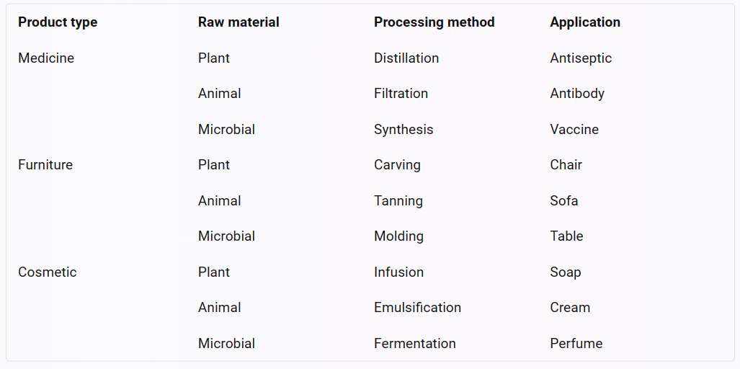
Creativity Techniques
Morphological Analysis
For example, using the following matrix to generate bio-based product ideas:

Slide 14
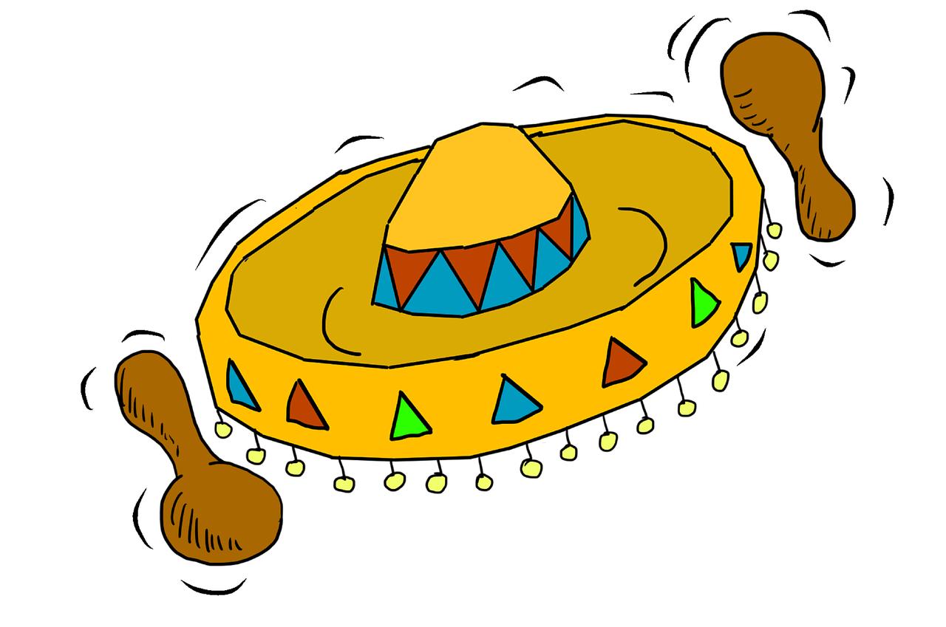
Creativity Techniques
Six Thinking Hats: De Bono
The six hats are not only names for thinking; they also symbolize six different ways of thinking. The hats are therefore applied proactively, as opposed to re-actively.
The approach encourages more individuals to contribute fully. According to de Bono, it "separates ego from performance". Since everyone is just using the yellow hat or another hat, they can all contribute to the exploration without hurting each other's egos. The six hats concept promotes performance above ego protection. Regardless of whether they originally favour the opposing viewpoint, anyone can assist in any capacity.
The important thing to remember is that a hat is a way to think rather than a name for thinking. The six thinking hats can be used, in theory, for the following purposes:
    Boost Parallel Thinking
    Boost full-spectrum thinking
    Separate ego from performance

Slide 15
Creativity Techniques
Six Thinking Hats: De Bono
White Hat
This covers facts, figures, information needs and gaps. "I think we need some white hat thinking at this point..." means Let's drop the arguments and proposals, and look at the data base."
Red Hat
This covers intuition, feelings and emotions. The red hat allows the thinker to put forward an intuition without any ned to justify it. "Putting on my red hat, I think this is a terrible proposal.“ The red hat gives full permission to a thinker to put forward his or her feelings on the subject at the moment.
Black Hat
This is the hat of judgment and caution. It is a most valuable hat. It is not in any sense an inferior or negative hat. The black hat is used to point out why a suggestion does not fit the facts, the available experience, the system in use, or the policy that is being followed. The black hat must always be logical.
Yellow Hat
This is the logical positive. Why something will work and why it will offer benefits. It can be used in looking forward to the results of some proposed action, but can also be used to find something of value in what has already happened.
Green Hat
This is the hat of creativity, alternatives, proposals, what is interesting, provocations and changes.
Blue Hat
This is the overview or process control hat. It looks not at the subject itself but at the 'thinking' about the subject. In technical terms, the blue hat is concerned with meta-cognition.
Facts
Feelings
Caution
Benefits
Creativity
Process

Slide 16
Creativity Techniques
For example, let’s suppose we want to create a product that uses algae as a raw material. We can use the six thinking hats to explore this idea as follows:
White hat: What are the facts and information about algae and its potential uses? For example, algae are photosynthetic organisms that can grow in water and produce biomass, oxygen, and biofuels. Algae can also be used to make food, feed, cosmetics, bioplastics, fertilizers, and other products.
Red hat: How do we feel about algae and its products? What are our intuitions and emotions? For example, we might feel excited about the environmental and economic benefits of algae, or we might feel disgusted by its appearance and smell. We might also have some biases or preferences for or against certain algae products.
Black hat: What are the potential risks, problems, or drawbacks of using algae as a raw material? For example, algae cultivation might require large amounts of water, land, energy, and nutrients. Algae might also produce harmful toxins or pollutants, or compete with other aquatic life. Algae products might also face regulatory, technical, or market barriers.
Yellow hat: What are the potential benefits, advantages, or opportunities of using algae as a raw material? For example, algae can provide a renewable and sustainable source of biomass and biofuels that can reduce greenhouse gas emissions and fossil fuel dependence. Algae can also produce valuable products that can improve human and animal health, nutrition, and well-being. Algae can also create new jobs and industries in the bioeconomy sector.
Green hat: How can we generate new ideas and possibilities for using algae as a raw material? What are some creative or innovative ways to use algae or its products? For example, we can brainstorm different types of algae products that can meet various needs and demands in different sectors. We can also think of ways to improve the efficiency and quality of algae cultivation and processing. We can also explore new applications or markets for algae products.
Blue hat: How can we manage and organize the thinking process about using algae as a raw material? What are the goals and objectives of this project? What are the steps and actions to take? What are the resources and tools to use? What are the criteria and indicators to measure success? For example, we can define the scope and purpose of the project, assign roles and responsibilities to the team members, plan the timeline and budget, conduct research and analysis, design and test prototypes, evaluate results and feedback, and communicate and disseminate findings.

Slide 17

Creativity Techniques
Five W’s and one H: Six Honest Serving-Men
“I keep six honest serving-men:
(They taught me all I knew)
Their names are What and Where and When
And How and Why and Who.”
From "The Elephant's Child" by Rudyard Kipling
Who?
Why?
What?
Where?
When?
How?

Slide 18

Creativity Techniques
Five W’s and one H: Six Honest Serving-Men
The Five W’s and H are a powerful, creative, and innovative checklist that journalists frequently employ. It is also known as “the Checklist”. The method makes use of the straightforward question-generating prompts that the English language offers. Any amount of formality or pure informality can benefit from the strategy. For instance:
The informal "back of an envelope" method can be used as a quick-aide checklist, a private checklist to remember while in a conversation, brief points to jot down at a meeting, or to spark further inquiries.
The checklist can be helpful as an informal or systematic method of producing lists of questions that you can try to discover answers for during the early phases of issue resolution when you are gathering data.
To come up with thought-provoking queries, The checklist might be used as a source of thought-provoking questions to assist building on current ideas while brainstorming, brainwriting, or using another similar approach.
The checklist could be used to assist in creating criteria for assessing possibilities.
The checklist is a valuable tool for developing implementation methods for plans.
The "question words," on the other hand, owe their power to the English language's essential place for them, and they can hide some of nature's best qualities that our language does not handle as well. The answers to the checklist's questions are frequently facts rather than statements about events or issues.

Slide 19

Creativity Techniques
Five W’s and one H: Six Honest Serving-Men
For example, suppose we want to create a product that uses coffee grounds as a raw material. We can use the five W’s and H technique to explore this idea as follows:
Who: Who are the potential customers or users of this product? Who are the competitors or collaborators in this market? Who are the suppliers or partners in this value chain? For example, the customers might be coffee lovers who want to reuse their coffee grounds for other purposes. The competitors might be other companies that offer similar products or services. The collaborators might be coffee shops or roasters that provide coffee grounds as a waste stream. The suppliers might be farmers or traders that produce or sell coffee beans.
What: What is the product or service that we want to offer? What are its features and benefits? What are its costs and revenues? What are its challenges and opportunities? For example, the product might be a biodegradable coffee cup made from coffee grounds. The features might include durability, insulation, aroma, composability. The benefits might include environmental friendliness, convenience, novelty. The costs might include production, packaging, distribution. The revenues might include sales, advertising, sponsorship. The challenges might include quality, safety, regulation. The opportunities might include differentiation, branding, education.

Slide 20

Creativity Techniques
Five W’s and one H: Six Honest Serving-Men
Where: Where is the market or demand for this product? Where is the source or supply of this raw material? Where is the location or facility for this production? Where is the distribution or delivery channel for this product? For example, the market might be in urban areas where coffee consumption is high. The source might be in rural areas where coffee cultivation is common. The production might be in industrial zones where processing equipment is available. The distribution might be on online platforms where e-commerce is popular.
When: When is the best time to launch or sell this product? When is the peak season or demand for this product? When is the optimal cycle or frequency for this production? When is the expiration or shelf life of this product? For example, the best time to launch might be in winter when hot drinks are more appealing. The peak season might be in spring when coffee festivals are held. The optimal cycle might be in weekly batches to ensure freshness and quality. The expiration might be in six months to prevent molding and degradation.

Slide 21
Creativity Techniques
Five W’s and one H: Six Honest Serving-Men
Why: Why do we want to create this product? Why do customers want to buy this product? Why do we choose coffee grounds as a raw material? Why do we use a certain method or technology for this production? For example, we want to create this product because we want to reduce waste and promote sustainability. Customers want to buy this product because they want to support the circular economy and enjoy a unique experience. We choose coffee grounds as a raw material because they are abundant, cheap, and versatile. We use a certain method or technology because they are efficient, effective, and innovative.
How: How do we create this product? How do we test and validate this product? How do we market and promote this product? How do we measure and improve this product? For example, we create this product by mixing coffee grounds with natural binders and moulding them into cups. We test and validate this product by conducting experiments and surveys. We market and promote this product by using social media and word-of-mouth. We measure and improve this product by collecting data and feedback.

Slide 22

Creativity Techniques
Random Words
Random Words works in particular by making you go elsewhere for ideas, and hence pushes you out of your current thinking rut. It uses the principle of forced association to make you think in new ways and create very different ideas.
Use it to stimulate open and divergent thinking and seek creative new ideas.
Use it to re-ignite creative thinking when you are running out of ideas.
Use it to get people out of a rut when their thinking is still rather conventional.

Slide 23
Creativity Techniques
Random Words
For example, using words such as:
Candle: A bioeconomy product idea inspired by candle could be a bio-wax that is made from vegetable oils or animal fats and emits a pleasant fragrance.
Guitar: A bioeconomy product idea inspired by guitar could be a bio-acoustic instrument that is made from wood or bamboo and produces natural sounds.
Pillow: A bioeconomy product idea inspired by pillow could be a bio-fibre that is made from cotton or hemp and provides comfort and support.
Candle
Guitar
Pillow

Slide 24

Creativity Techniques
Mind Mapping
The mind-map may be produced in any tree-shaped format and is really just a simple hierarchy in its most basic form.
Making notes in cursive type or even as a list of bullet points takes effort and often complicates important information.
Mind mapping circumvents these restrictions. Writing branches on curved lines enables them to curve differently in the next branches, creating a corner apex between each branch and thereby separating them (but not too much).
Instead of placing the text on the lines themselves, you might write the words separately and connect them with lines.
Use what works for you when mind mapping, that is the main rule. This entails trying new things, which is obviously acceptable and encouraged, especially in a creative setting.
The brain works by association and thinks in pictures and wholes. Mind-maps aligns with this tendency by showing associative links and being visible as a whole.

Slide 25
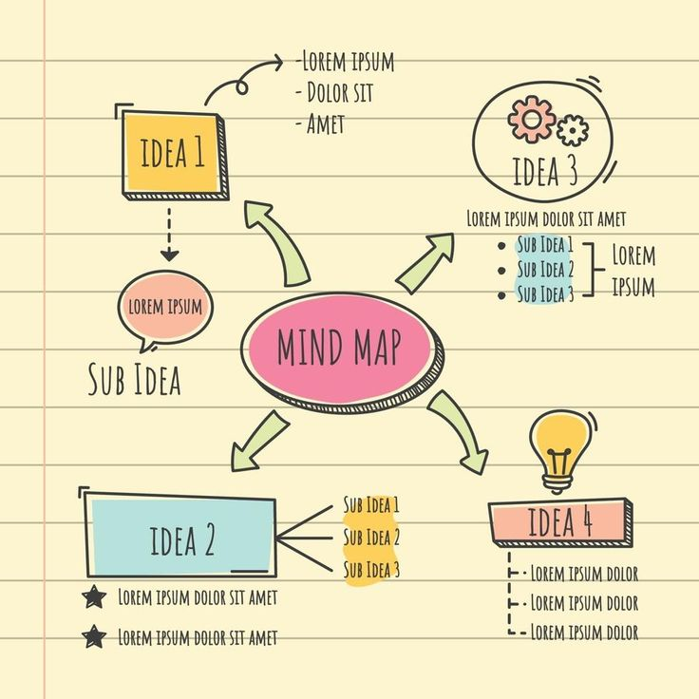
Creativity Techniques
Mind Mapping
For example, suppose we want to create a product that uses mushroom as a raw material. We can use a mind map to explore this idea as follows:
Central concept: Mushroom biobased product
Branching topics:
  Types of mushrooms: edible, medicinal, psychedelic, etc.
  Sources of mushrooms: wild, cultivated, imported, etc.
  Properties of mushrooms: nutritional, medicinal, ecological, etc.
  Applications of mushrooms: food, medicine, textile, packaging, etc.
  Benefits of mushrooms: health, environment, economy, culture, etc.
  Challenges of mushrooms: cultivation, processing, regulation, perception, etc.
  Solutions for mushrooms: innovation, education, collaboration, advocacy, etc.

Slide 26
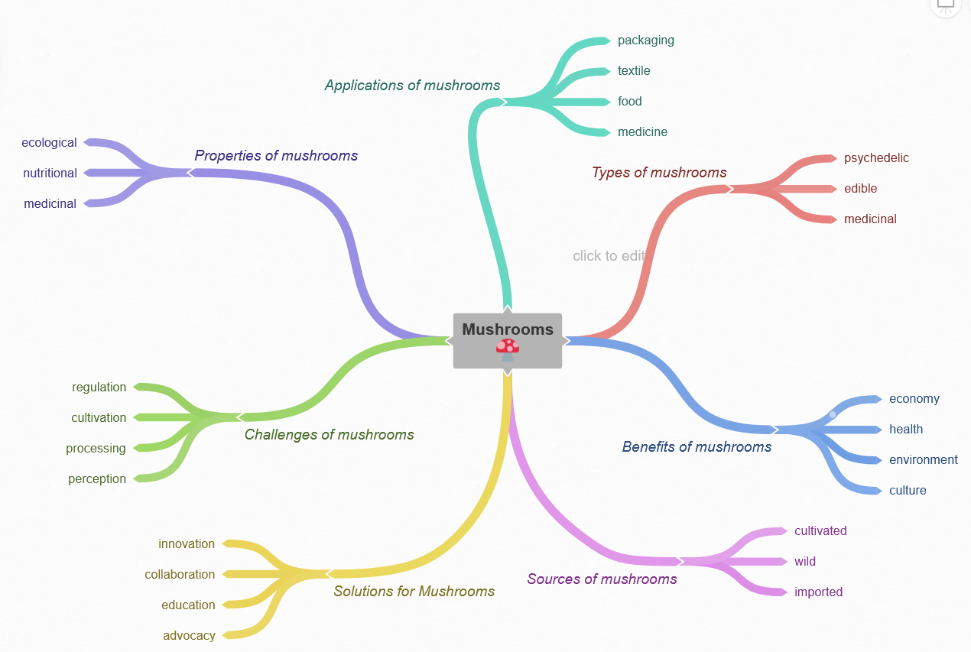
Creativity Techniques
Mind Mapping

Slide 27
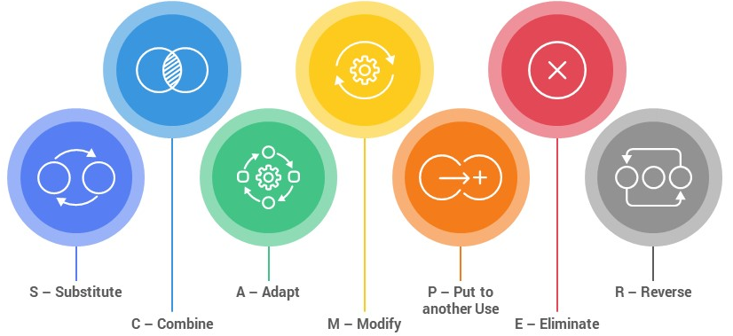
Creativity Techniques
SCAMPER
SCAMPER works by providing a list of active verbs that you associate with your problem and hence create ideas. As they are all verbs, they are about doing, and so get you to think about action.
SCAMPER is an acronym for useful list of words that can be applied as stimuli to make you think differently about the problem area.

Slide 28
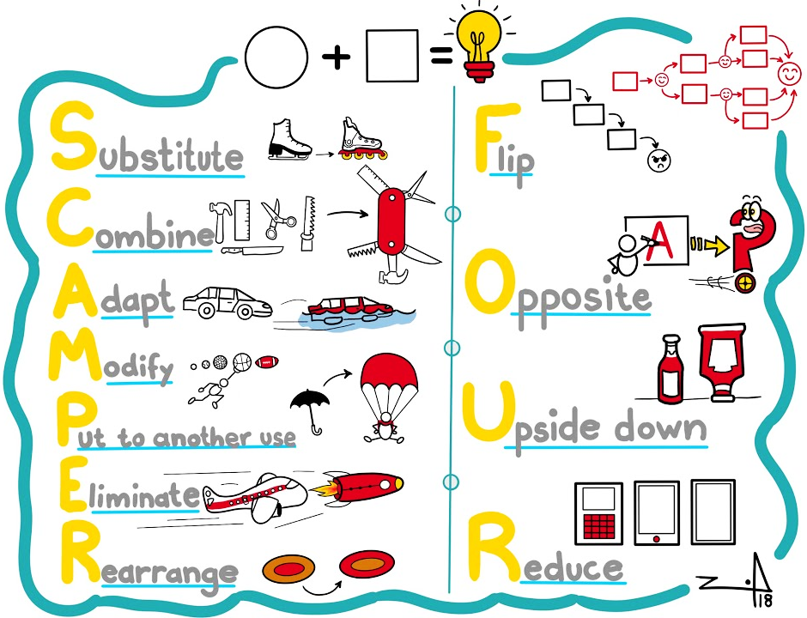
Creativity Techniques
SCAMPER
For example:
  substitute plastic bottles with biodegradable ones made from algae,
  combine solar panels with plants to produce electricity and oxygen,
  adapt mushrooms to grow into furniture or packaging,
  modify bacteria to produce insulin or antibiotics,
  put coffee grounds to another use as fertilizer or fuel,
  eliminate harmful chemicals from cleaning products with enzymes or microorganisms,
  reverse the process of making paper from wood to make wood from paper.

Slide 29

Food for Thought
Watch the Video and by applying some of the creativity techniques come up with ideas that can be created using Fungus.

Slide 30


Slide 31
BioBeo Project
Innovative Education for the Bioeconomy
www.biobeo.eu

